Slide 1
CANCER THERAPIES: REPURPOSED DRUGS & NATURAL SUBSTANCES Aug 14, 2021 PART Three
Jeffrey Dach MD 7450 Griffin Road Suite 190 Davie, FL 33021 954-792-4663
Copyright 2021 © Jeffrey Dach MD
Notes:
Jeffrey Dach MD 7450 Griffin Road Suite 190 Davie, FL 33021 954-792-4663 www.jeffreydachmd.com

Slide 2
Cancer As a Trophoblastic Disease
Contact Info:
7450 Griffin Rd Ste 190 Davie, FL 33021 954-792-4663
Jeffreydachmd.com
Copyright 2021 © Jeffrey Dach MD
All Rights Reserved

Slide 3
Three Pillars of Cancer Cell Metabolism
GLYCOLYSIS
OXPHOS
Autophagy
Notes:
https://commons.wikimedia.org/wiki/File:Three_in_a_row_-_National_Capitol_Columns.jpg
Of equal importance are fourth and fifth
factors, the cancer cell’s escape from immune
surveillance, and upregulation of inflammation.

Slide 4
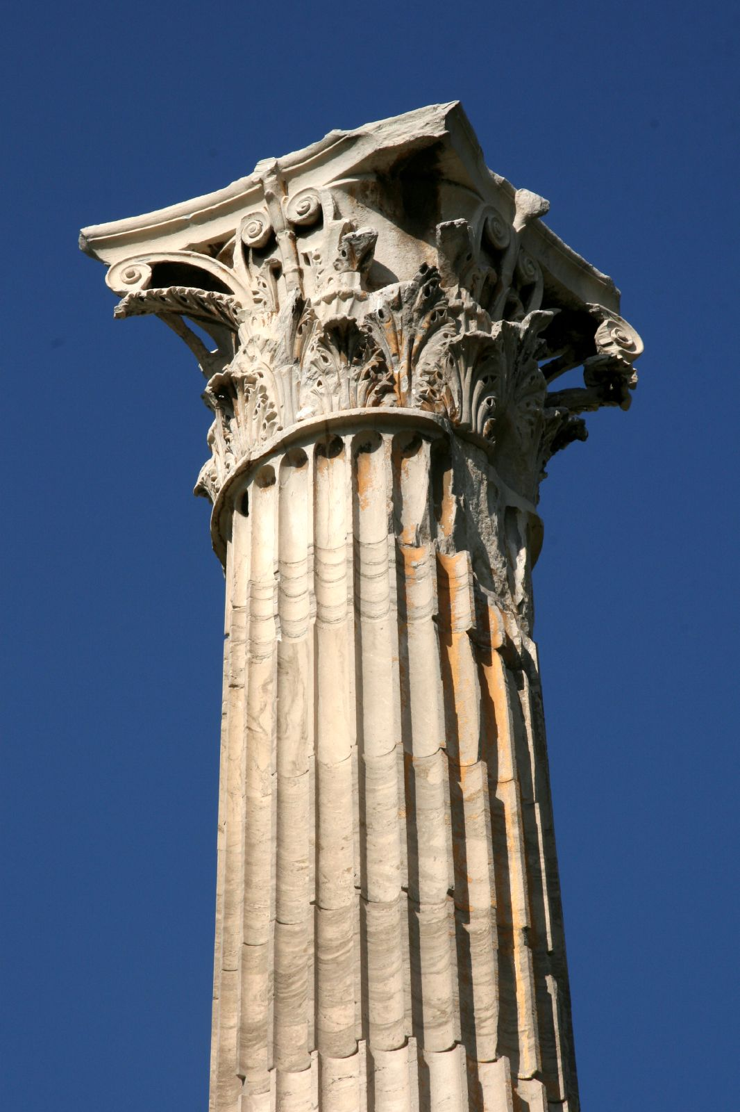
Fourth Pillar
Restore
Host
Immune Surveillance
Notes:
https://commons.wikimedia.org/wiki/File:Corinthian_Column_of_the_Temple_of_Zeus_in_Athens.jpg
Of equal importance are fourth and fifth
factors, the cancer cell’s escape from immune
surveillance, and upregulation of inflammation.

Slide 5
Fifth Pillar
Upregulation Inflammatory Pathways
NF-kB, IL-6, COX-2, 5-LOX
Notes:
https://commons.wikimedia.org/wiki/File:Corinthian_Column_of_the_Temple_of_Zeus_in_Athens.jpg
Of equal importance are fourth and fifth
factors, the cancer cell’s escape from immune
surveillance, and upregulation of inflammation.
Immunologic phases of pregnancy
Each stage of pregnancy is characterized by a unique inflammatory environment. The first and third trimesters are proinflammatory (TH1), whereas the second trimester represents an anti-inflammatory phase also knowns and TH2 environment.
Mor, Gil, et al. "Inflammation and pregnancy: the role of the immune system at the implantation site." Annals of the new York Academy of Sciences 1221.1 (2011): 80.

Slide 6
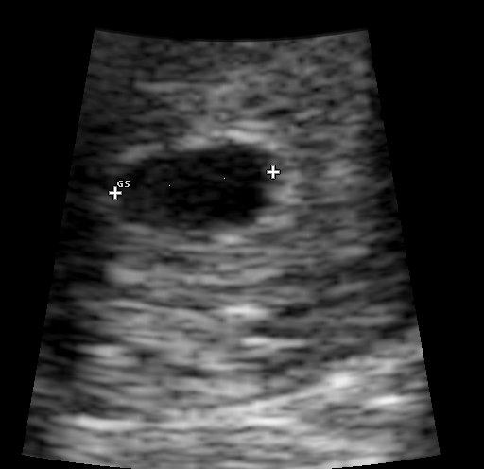
US Early Pregnancy
https://commons.wikimedia.org/wiki/File:Pregnancy_ultrasound_110302114249_1145551.jpg
Notes:
File:Pregnancy ultrasound 110302114249 1145551.jpg
Healing is Voltage: The Handbook, 3rd Edition Paperback – June 21, 2010 by Jerry L. Tennant (Author)

Slide 7
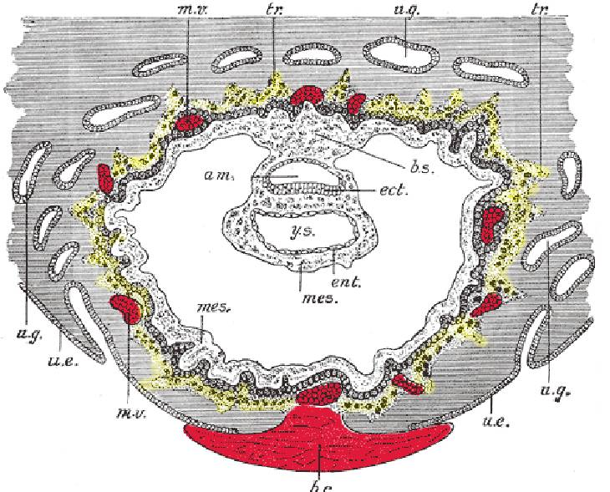
What Is the Trophoblast ?
1918: Grays Anat: Section through ovum imbedded in uterine decidua.
b.s. Body-stalk. ect. Embryonic ectoderm. ent. Entoderm.
Mes Mesoderm m.v. Maternal vessels. tr. Trophoblast. u.e. Uterine epithelium. u.g. Uterine glands. y.s. Yolk-sac.
Notes:
Description Section through ovum imbedded in the uterine decidua. Semidiagrammatic. (After Peters.) am. Amniotic cavity. b.c. Blood-clot. b.s. Body-stalk. ect. Embryonic ectoderm. ent. Entoderm. mes. Mesoderm. m.v. Maternal vessels. tr. Trophoblast. u.e. Uterine epithelium. u.g. Uterine glands. y.s. Yolk-sac.
Plate 32
Date before 1858
Source Henry Gray (1918) Anatomy of the Human Body (See "Book" section below)
Bartleby.com: Gray's Anatomy, Plate 32
Author Henry Vandyke Carter (1831–1897) Blue pencil.svg wikidata:Q955620 s:en:Author:Henry Vandyke Carter

Slide 8
Hints: Cancer as a Trophoblastic Disease
A Few Hints from Earlier Presentations:
Hexokinase II is Embryonic Enzyme, not usually found in somatic cells (a few exceptions).
Wnt Pathway is Embryonic Stem Cell pathway, usually Dormant in Somatic cells.
Cancer/Testis Genes-Antigens, PLAC1 , HCG, PIBF
4th, 5th Pillar Immune Tolerance, Inflammation.
Old, Lloyd J. "Cancer is a somatic cell pregnancy." (2007)
Kalejs, Martins, and Jekaterina Erenpreisa. "Cancer/testis antigens and gametogenesis: a review and" brain-storming" session." Cancer cell international 5.1 (2005): 1-11.
Ma, JIachi, et al. "PLAC1 Enhances Metastatic Potential and is Associated with PI3K/AKT/NF-κB Signaling Pathway in Colon Cancer." (2019).
Liu, Chunfang, et al. "Abnormal gametogenesis induced by p53 deficiency promotes tumor progression and drug resistance." Cell discovery 4.1 (2018): 1-16.
Copyright 2021 © Jeffrey Dach MD
Notes:
The century-old embryonal/gametogenesis theory of
tumors proposed that tumors arise from germ cells and
thus are in some way similar to the formation of gametes
and fertilization
Old extended the hypothesis postu-
lating that the silenced gametogenic program is reacti-
vated in tumors and serves as one of the driving forces for
tumorigenesis2,3
placenta-specific protein 1 (PLAC1) in human colorectal cancer
The activation of PI3K/Akt/NF-κB signaling by PLAC1 may be critical for the metastasis of
colorectal cancer cells. According to our results, we suggest that modification of PLAC1 function might
be a promising new therapeutic approach to inhibit the aggressive spread of colorectal cancer.
Many genes normally expressed in
the embryo become reactivated in cancer cells, and PLAC1 was the first such cancer/testis gene that
related placentation to cancer. Silva, et al. first reported that PLAC1 RNA was expressed in human
cancer cell lines covering 17 different malignancies, including colorectal cancer.
CT antigens are a unique set of antigens expressed in germ cells of
the testis and various malignancies of different histological origin
but not in healthy somatic tissues
Cancer/testis antigens (CTA) are expressed by a wide range of tumors, but are minimally expressed on normal tissues, and could serve as a universal target for immunotherapy
Cancer-testis antigens (CTA) are tumor antigens, present in the germ cells of testes, ovaries and trophoblasts, which undergo deregulated expression in the tumor and malignant cells.
CT Antigens Discovered
Another twist to the story is the recent discovery of a new class of human tumor antigens called CT (cancer/testis) antigens.(49-52) About 90 genes have been found having messenger RNA expression in both germ cells (testis) and cancer cells, and no expression in otherwise normal cells. This is further evidence linking the trophoblast cells, which are, in fact, germ cells (also called stem cells), with cancer cells. These recent advances in molecular biology have shown that John Beard was quite correct to point out the similarity between placental trophoblast cells and malignant cancer cells. Beard's forgotten predictions in the early 1900's seem to have an uncanny way of resurfacing 100 years later.

Slide 9
Cancer as a Trophoblastic Disease
“The trophoblastic program is found in a strictly dormant state in every cell of the body, as evidenced through reproductive cloning by transfer of the nucleus of a somatic cell into a denucleated oocyte. It seems to be reactivated in cancer cells, endowing them with pro-survival and latent mesenchymal properties, and to play a key functional role in cancer tissue regulation, in particular in expansion of mesenchyme-related myofibroblastic CAFs”.(Piechowski, 2019)
Piechowski, Jean. "Plausibility of trophoblastic-like regulation of cancer tissue." Cancer management and research 11 (2019): 5033.
Copyright 2021 © Jeffrey Dach MD
Notes:
The concept of cancer cell trophoblastic-like transdifferentiation appears to be a rational proposal in an attempt to explain this analogy and provide a consistent insight into how cancer cells are functioning.
it turns out that a physiological condition, involving a singular multifunctional tissue interrelation, is strikingly plagiarized by cancer tissues. It is the implantation of trophoblast, ie, the early placenta,7 in endometrium.
Aggressiveness of cancer cells correlates with high production of TGF-β, stiff stroma and high mechanotransduction signaling, all of them presenting a positive gradient towards the invasive front of the tumor.40 Increase of TGF-β also strengthens the local immune tolerance, this being true for cancer tissue and trophoblast. Another aspect of malignancy is the prometastatic action of TGF-β through its active promotion of EMT with type switching of cadherins and integrins, a condition conducive to cell migration, just as in the case of the invasive extravillous cytotrophoblast.
An oocyte is the very beginning of human life - in the simplest of terms, it is an immature egg cell.

Slide 10
Clone a Normal Nucleus into Tumor Cell
Normal Cytoplasm, Cancer Nucleus
Tumor Cell, Normal Nucleus
Normal Cells
Tumor Cells / Death
Seyfried, Thomas N. "Cancer as a metabolic disease: " Carcinogenesis (2014):
Copyright 2021 © Jeffrey Dach MD
Notes:
Original diagram from Jeffrey Ling and Thomas N. Seyfried, with permission.

Slide 11
Unified Mechanistic Framework
“The concept in which the trophoblastic master genes act as master regulators of malignancy, would represent a unified mechanistic framework for the different types of cancer”... (Piechowski, 2019)
TGF β - A Key Player in Trophoblast Implantation and Cancer Aggressivity
Piechowski, Jean. "Plausibility of trophoblastic-like regulation of cancer tissue." Cancer management and research 11 (2019): 5033.
Copyright 2021 © Jeffrey Dach MD
Notes:
The concept of cancer cell trophoblastic-like transdifferentiation appears to be a rational proposal in an attempt to explain this analogy and provide a consistent insight into how cancer cells are functioning.
it turns out that a physiological condition, involving a singular multifunctional tissue interrelation, is strikingly plagiarized by cancer tissues. It is the implantation of trophoblast, ie, the early placenta,7 in endometrium.
Aggressiveness of cancer cells correlates with high production of TGF-β, stiff stroma and high mechanotransduction signaling, all of them presenting a positive gradient towards the invasive front of the tumor.40 Increase of TGF-β also strengthens the local immune tolerance, this being true for cancer tissue and trophoblast. Another aspect of malignancy is the prometastatic action of TGF-β through its active promotion of EMT with type switching of cadherins and integrins, a condition conducive to cell migration, just as in the case of the invasive extravillous cytotrophoblast.

Slide 12
The Mystery of Maternal-Fetal Tolerance
2020, Dr. Nada Al-Khunaizi: the exact mechanism of “maternal-fetal tolerance” is still a mystery to medical science:
“Fetal antigens are allogeneic [foreign] to the mother’s immune system and should theoretically elicit an immune response. The fact that this does not occur… without undergoing rejection by her immune system is a scientific mystery.”
Al‐Khunaizi, Nada Is there a Role for HLA‐G in the Induction of Regulatory T cells during the Maintenance of a Healthy Pregnancy?.” Am J Repro Immuno (2020)
Jørgensen, Nanna,. "The tolerogenic function of regulatory T cells in pregnancy and cancer." Frontiers in immunology 10 (2019): 911.
Copyright 2021 © Jeffrey Dach MD
Notes:
In order for a pregnancy to proceed, the trophoblast
must disable the mother’s immune system.
Otherwise, the developing embryo, which
is 50% genetically different from the mother,
would be rejected, much like a rejected organ
transplant. (1–2)

Slide 13
Cancer/Trophoblast - TGF-β
“Increase of TGF-β also strengthens the local immune tolerance, this being true for cancer and trophoblast….Another aspect of malignancy is prometastatic action of TGF-β through its active promotion of EMT…a condition conducive to cell migration, just as in the case of the invasive extravillous cytotrophoblast.”.(Piechowski, 2019)
Piechowski, Jean. "Plausibility of trophoblastic-like regulation of cancer tissue." Cancer management and research 11 (2019): 5033.
Copyright 2021 © Jeffrey Dach MD
Notes:
The concept of cancer cell trophoblastic-like transdifferentiation appears to be a rational proposal in an attempt to explain this analogy and provide a consistent insight into how cancer cells are functioning.
it turns out that a physiological condition, involving a singular multifunctional tissue interrelation, is strikingly plagiarized by cancer tissues. It is the implantation of trophoblast, ie, the early placenta,7 in endometrium.
Aggressiveness of cancer cells correlates with high production of TGF-β, stiff stroma and high mechanotransduction signaling, all of them presenting a positive gradient towards the invasive front of the tumor.40 Increase of TGF-β also strengthens the local immune tolerance, this being true for cancer tissue and trophoblast. Another aspect of malignancy is the prometastatic action of TGF-β through its active promotion of EMT with type switching of cadherins and integrins, a condition conducive to cell migration, just as in the case of the invasive extravillous cytotrophoblast.
An oocyte is the very beginning of human life - in the simplest of terms, it is an immature egg cell.

Slide 14
First, Third Trimesters - Inflammatory
First trimester of pregnancy is a Pro-Inflammatory phase, responsible for “Morning Sickness”.
2nd Trimester Anti-Inflammatory.
3rd Trimester Pro-Inflammatory, Contraction of Uterus, Rejection of Placenta.
Mor, Gil, et al. "Inflammation and pregnancy: the role of the immune system at the implantation site." Annals of the New York Academy of Sciences 1221.1 (2011): 80.
Copyright 2021 © Jeffrey Dach MD
Notes:
Mor, Gil, et al. "Inflammation and pregnancy: the role of the immune system at the implantation site." Annals of the new York Academy of Sciences 1221.1 (2011): 80.
Implantation, placentation, and the first and early second trimester of pregnancy resemble “an open wound” that requires a strong inflammatory response. During this first stage, the blastocyst has to break through the epithelial lining of the uterus in order to implant; damage the endometrial tissue to invade; followed by the trophoblast replacement of the endothelium and vascular smooth muscle of the maternal blood vessels in order to secure an adequate placental-fetal blood supply [39]. All these activities create a veritable “battleground” of invading cells, dying cells, and repairing cells. An inflammatory environment is required in order to secure the adequate repair of the uterine epithelium and the removal of cellular debris [10, 40]. Meanwhile, the mother’s well-being is clinically affected: she feels sick because her whole body is struggling to adapt to the presence of the fetus (in addition to hormone changes and other factors, this inflammatory response is responsible for “morning sickness”). Thus, the first trimester of pregnancy is a proinflammatory phase [29, 41].
Finally, during the last immunological phase of pregnancy, the fetus has completed its development; all the organs are functional and ready to deal with the external world. Now the mother needs to deliver the baby, and this can only be achieved through renewed inflammation. Parturition is characterized by an influx of immune cells into the myometrium in order to promote recrudescence of an inflammatory process [42, 43]. This proinflammatory environment promotes the contraction of the uterus, expulsion of the baby and rejection of the placenta. In conclusion, pregnancy is a proinflammatory and anti-inflammatory condition, depending upon the stage of gestation [44]–[45].
Immunologic phases of pregnancy
Each stage of pregnancy is characterized by a unique inflammatory environment. The first and third trimesters are proinflammatory (TH1), whereas the second trimester represents an anti-inflammatory phase also knowns and TH2 environment.

Slide 15
First Trimester Inflammatory State REF
Chavan, Arun Rajendra, "The inflammation paradox in the evolution of mammalian pregnancy: turning a foe into a friend." Cur Op in Gen & Dev (2017) Koga, Kaori, and Gil Mor. "Toll‐like receptors and pregnancy: trophoblast as modulators of the immune response." J Ob Gyn Res 35.2 (2009): 191-202.
Sargent, I. L., et al. "Trophoblast deportation and the maternal inflammatory response in pre-eclampsia." J of reproductive immunology 59.2 (2003):
Lee, Seung Mi, et al. "Systemic inflammatory stimulation by microparticles derived from hypoxic trophoblast as a model for inflammatory response in preeclampsia." American journal of obstetrics and gynecology 207.4 (2012):
Fest, Stefan, et al. "Trophoblast–macrophage interactions: a regulatory network for the protection of pregnancy." Am j of repro immunology 57.1 (2007): 55-66.
Pijnenborg, Robert. "Implantation and immunology: maternal inflammatory and immune cellular responses to implantation and trophoblast invasion." Reproductive biomedicine online 4 (2002): 14-17.
Hamelin-Morrissette, Jovane, et al. "Leukemia inhibitory factor regulates the activation of inflammatory signals in macrophages and trophoblast cells." Molecular immunology 120 (2020): 32-42.
Copyright 2021 © Jeffrey Dach MD
Notes:
Mor, Gil, et al. "Inflammation and pregnancy: the role of the immune system at the implantation site." Annals of the new York Academy of Sciences 1221.1 (2011): 80.
Implantation, placentation, and the first and early second trimester of pregnancy resemble “an open wound” that requires a strong inflammatory response. During this first stage, the blastocyst has to break through the epithelial lining of the uterus in order to implant; damage the endometrial tissue to invade; followed by the trophoblast replacement of the endothelium and vascular smooth muscle of the maternal blood vessels in order to secure an adequate placental-fetal blood supply [39]. All these activities create a veritable “battleground” of invading cells, dying cells, and repairing cells. An inflammatory environment is required in order to secure the adequate repair of the uterine epithelium and the removal of cellular debris [10, 40]. Meanwhile, the mother’s well-being is clinically affected: she feels sick because her whole body is struggling to adapt to the presence of the fetus (in addition to hormone changes and other factors, this inflammatory response is responsible for “morning sickness”). Thus, the first trimester of pregnancy is a proinflammatory phase [29, 41].
Finally, during the last immunological phase of pregnancy, the fetus has completed its development; all the organs are functional and ready to deal with the external world. Now the mother needs to deliver the baby, and this can only be achieved through renewed inflammation. Parturition is characterized by an influx of immune cells into the myometrium in order to promote recrudescence of an inflammatory process [42, 43]. This proinflammatory environment promotes the contraction of the uterus, expulsion of the baby and rejection of the placenta. In conclusion, pregnancy is a proinflammatory and anti-inflammatory condition, depending upon the stage of gestation [44]–[45].
Immunologic phases of pregnancy
Each stage of pregnancy is characterized by a unique inflammatory environment. The first and third trimesters are proinflammatory (TH1), whereas the second trimester represents an anti-inflammatory phase also knowns and TH2 environment.

Slide 16
Early Pathologists Thought Cancer is a Trophoblastic Disease
William Beard (1858–1924)
William Donald Kelley, DDS (1926–2005)
Nicholas Gonzalez, MD (1947, 2015) (68yrs) Denver, Boulderfest conference July 17-20 2008, Robert Crayhon: 1961-2010 age 49. colon cancer
5) Gonzales NJ, Isaacs LL. The Trophoblast and the Origins of Cancer: One Solution to the Medical Enigma of Our Time. New York, NY: New Spring Press; 2009.
6) Ross, Colin A. “The trophoblast model of cancer.” Nutrition and cancer 67.1 (2015): 61-67.
Copyright 2021 © Jeffrey Dach MD
Notes:
Cancer as a Trophoblastic Disease:
This is the theory that cancer is a form of “placental cell” or “germ cell” which uses many of the same molecular circuits as trophoblast cells use, to invade locally, induce its own blood supply, and evade the immune system of the host. The trophoblast is the Placental Cell of Pregnancy. Both cancer cells and trophoblast cells secrete HCG (human chorionic gonadotropin) and PIBF (progesterone induced blocking factor). (41)
Nicholas Gonzalez, MD, a keynote speaker at a medical conference I attended in Denver Colorado (Boulderfest conference July 17-20 2008.)
On Saturday, September 4, 2010, the world of nutrition and integrative health lost a giant figure.
On that day, Robert Crayhon lost his battle with cancer. He was 49.
On December 3,1890 the Scottish pathologist William Russell reported a “cancer microbe” seen under his microscope inside cancer cells. His report in the Dec 18, 1890 British Medical Journal included detailed drawings describing parasitic spores within cancer cells.(24) Over the next 120 years, Dr Russell’s hypothesis that cancer is a parasitic disease was picked up and championed by a long list of impressive scientists.(80) However all were labeled as medical heretics and lived out their careers in obscurity. Left Image: Microsporidian spore courtesy of wikimedia. This organism is a spore-forming unicellular parasite, once thought to be protozoans, now known to be fungi.

Slide 17
Enzyme Treatment of Cancer
Day 56, Zymogen Granules Appear in Pancreas,
At which time, Trophoblast Transforms from Aggressive to Benign (could it be the enzymes ?).
1906: William Beard Suggested Use of Digestive Enzymes (Trypsin) to Treat Cancer.
Enzyme Rx Was Never Accepted by Mainstream Medicine.
9) Beard J. The Enzyme Treatment of Cancer. London: Chatto & Windus, 1911.
10) Beard, John. “The Action of Trypsin upon the Living Cells of Jensen’s Mouse-Tumor.” British medical journal 1.2351 (1906): 140.
Copyright 2021 © Jeffrey Dach MD

Slide 18
References for Preceding Slide
16) Mullen, Catherine A. “Analogies between trophoblastic and malignant cells.” American Journal of Reproductive Immunology 39.1 (1998): 41-49.
17) Lala, P. K., et al. “Human placental trophoblast as an in vitro model for tumor progression.” Canadian j of physiol and pharm 80.2 (2002):142-149.
18) Koslowski, M. “Placenta-specific gene ectopically activated in many cancers is essentially involved in malignant cell processes.” Can res 67.19 (2007): 95
syngeneic melanoma B16.” Cancer chemo and pharm 47.1 (2001): S16-S22.
Vazquez-Martin, A. "Somatic polyploidy is associated with the upregulation of c-MYC interacting genes and EMT-like signature." Oncotarget 7.46 (2016): 75235.
Erenpreisa, Jekaterina, et al. "The “virgin birth”, polyploidy, and the origin of cancer." Oncoscience 2.1 (2015): 3.
Liu, Jinsong. "The “life code”: A theory that unifies the human life cycle and the origin of human tumors." Sem in cancer biology. Vol. 60. Academic Press, 2020.
26) Cutfield, A: “Trypsin Treatment in Malignant Disease” Br Med J 5, 525, 1907.
27) Wiggin, FH: “Case of Multiple Fibrosarcoma of The Tongue, Use of Trypsin and Amylopsin in the Treatment of Malignant Disease” JAMA 47, 2003-08. 1906.
31) Wald, Martin, et al. “Mixture of trypsin, chymotrypsin and papain reduces formation of metastases and extends survival time of C 57 Bl 6 mice with
Copyright 2021 © Jeffrey Dach MD

Slide 19
Both Cancer and Troph Cells Produce HCG
Both Cancer and Trophoblast Cells produce HCG (Acevedo, 1995)
The HCG test is both a pregnancy test and a cancer test.
11) Acevedo HF. Human chorionic gonadotropin-beta subunit gene expression in cultured human fetal and cancer cells. Cancer. 1995 Oct 15;76(8):1467.
13) Acevedo HF. Metastatic phenotype correlates with high expression of membrane-associated beta-HCG in vivo. Cancer. 1996 Dec 1; 78(11):2388
14) Regelson W. Have we found the “definitive cancer biomarker”? The diagnostic and therapeutic implications of HCG-beta expression as a key to malignancy. Cancer. 1995; 76:1299-301.
Copyright 2021 © Jeffrey Dach MD
Notes:
After conception, the developing ovum sends
trophoblast cells as finger-like extensions to
invade the endometrium, forming the placenta.
This layer of trophoblast cells, now called the
placenta, induces the maternal blood vessels to
grow into the placenta, providing blood flow to
the developing fetus. This invasive, infiltrative
behavior is very similar to the way cancer cells
infiltrate and invade surrounding tissues.

Slide 20
Both T and C / GLYCOLYSIS (+ Pet Scan)
Cancer cells Share the Same Metabolic Activities as Trophoblast cells, i.e. the “Warburg Effect.”
Both have High Glucose utilization, produce Lactate, Shifting from OXPHOS to GLYCOLYSIS. (Warburg Effect).
Thrive in a low 02 Environment.
Redel, B.K., Glycolysis in preimplantation development is partially controlled by the Warburg effect. Mol. Reprod. Dev. 79, 2012 262–271
Smith, Danielle G., and Roger G. Sturmey. "Parallels between embryo and cancer cell metabolism." Biochemical Society Transactions 41.2 (2013): 664-669.
Sawatzke, Alexander B., et al. "PET/CT imaging reveals unrivaled placental avidity for glucose compared to other tissues." Placenta 36.2 (2015): 115-120.
Warburg O. The Metabolism of Carcinoma Cell . J Cancer Res 1925; 9:148-163.
Old, Lloyd J. “Cancer is a Somatic Cell Pregnancy.” (2007): 19.
Bax, Bridget E "Energy metabolism and glycolysis in human placental trophoblast cells during differentiation." Biochimica et Biophysica Acta (1997): 283-292.
Copyright 2021 © Jeffrey Dach MD
Notes:
37) Warburg O. The Metabolism of Carcinoma Cells. J
Cancer Res 1925; 9:148-163.
38) Old, Lloyd J. “Cancer is a Somatic Cell Pregnancy.”
(2007): 19.

Slide 21
Both TR/CA Share Same Molecular Circuitry
2006, Dr. C. Ferretti:
Activation of PI3K/AKT axis as Central Feature.
Up-Regulation of Oncogene C-Myc.
Up-Regulation of Growth Factors: TGF-β, PDGF, EGFR, VEGF, (many others).
Proteolytic Enzymes: Matrix Metalloproteinases, (MMPs).
Autocrine and Paracrine Loops: (EGFR), hepatocyte (HGFR), (VEGFR).
15) Ferretti, C., et al. “Molecular circuits shared by placental and cancer cells, and their implications in the proliferative, invasive and migratory capacities of trophoblasts.”
Human reproduction update 13.2 (2007): 121-141.
Copyright 2021 © Jeffrey Dach MD
Notes:
PI3K/Akt/mTOR inhibitors – all
activate protective autophagy
Boswellia
Ivermectin PAK1 Inhibitor-mTOR
Itraconazole Also autophagy inhibitor by inhibition
of NPC1 (Niemann-Pick C1) a lysosomal membrane
protein.
Propranolol
Pterostilbene
Quercetin
Solomon’s seal
In 2006, Dr. C. Ferretti et al.
wrote that both cancer and trophoblast cells
share the same molecular circuitry for their
proliferative, invasive, and migratory capacities.
Activation of the phosphatidylinositol
3’-kinase PI3K/AKT axis as central feature
of signaling pathways for proliferative,
migratory and invasive processes.

Slide 22
PI3K/Akt/mTOR inhibitors – All Activate Protective Autophagy
Baicalein (Chi Skull)
Boswellia
Curcumin
EGCG
Ivermectin
Itraconazole
Metformin
Parthenolide (Feverfew)
Propranolol
Pterostilbene
Quercetin
Silybin (milk thistle)
Solomon’s Seal
Sulforaphane
Copyright 2021 © Jeffrey Dach MD
Notes:
PI3K/Akt/mTOR inhibitors – all
activate protective autophagy
Boswellia
Ivermectin PAK1 Inhibitor-mTOR
Itraconazole Also autophagy inhibitor by inhibition
of NPC1 (Niemann-Pick C1) a lysosomal membrane
protein.
Propranolol
Pterostilbene
Quercetin
Solomon’s seal
In 2006, Dr. C. Ferretti et al.
wrote that both cancer and trophoblast cells
share the same molecular circuitry for their
proliferative, invasive, and migratory capacities.
Activation of the phosphatidylinositol
3’-kinase PI3K/AKT axis as central feature
of signaling pathways for proliferative,
migratory and invasive processes.

Slide 23
PI3K/Akt/mTOR inhibitors Refs.
Sui, Xinbing "Baicalin induces apoptosis and suppresses cell cycle progression of lung cancer by downregulating Akt/mTOR signaling." Front in Mole Bio (2021)
Chaudhuri, D "Antiproliferative activity of sulforaphane in Akt-overexpressing ovarian cancer cells." Molecular cancer therapeutics 6.1 (2007): 334-345.
Borges, Gabriel"Curcumin downregulates PI3K–AKT–mTOR pathway and inhibits growth and progression in head and neck cancer cells." Phytother Res (2020)
Issinger, Olaf-Georg "Phytochemicals in cancer and their effect on the PI3K/AKT-mediated cellular signalling." Biomed & Pharm 139 (2021): 111650.
Wang, Wenping. "Itraconazole exerts anti-liver cancer potential through Wnt, PI3K/AKT/mTOR, and ROS pathways." Biomed & Pharma 131 (2020): 110661.
Zhao, Yan. "Metformin is associated with reduced proliferation in endometrial cancer by inhibiting PI3K/AKT/mTOR signaling." Gyne Endo 34.5 (2018): 428
Zhang, Xiaohong,"Ivermectin augments efficacy of cisplatin in epithelial ovarian cancer by suppressing Akt/mTOR signaling." Amer J med sci (2020): 123-129.
Li, Dongfan "Downregulation of miR-382 by propranolol inhibits progression of infantile hemangioma via AKT/mTOR pathway." Int j of molec med 39.3 (2017) Zhang, Hong, et al. "Lectin PCL inhibits the Warburg effect of PC3 cells by combining with EGFR and inhibiting HK2." Oncology reports 37.3 (2017):
Copyright 2021 © Jeffrey Dach MD
Notes:
PI3K/Akt/mTOR inhibitors – all
activate protective autophagy
Boswellia
Ivermectin PAK1 Inhibitor-mTOR
Itraconazole Also autophagy inhibitor by inhibition
of NPC1 (Niemann-Pick C1) a lysosomal membrane
protein.
Propranolol
Pterostilbene
Quercetin
Solomon’s seal
In 2006, Dr. C. Ferretti et al.
wrote that both cancer and trophoblast cells
share the same molecular circuitry for their
proliferative, invasive, and migratory capacities.
Activation of the phosphatidylinositol
3’-kinase PI3K/AKT axis as central feature
of signaling pathways for proliferative,
migratory and invasive processes.

Slide 24
Identical Molecular Circuitry
“Trophoblastic and cancer cells use comparable mechanisms implemented by identical molecular circuitries to achieve their proliferative, migratory and invasive processes.” (Ferretti, 2007)
15) Ferretti, C., et al. “Molecular circuits shared by placental and cancer cells, and their implications in the proliferative, invasive and migratory capacities of trophoblasts.” Hum repro upd 13.2 (2007).
Carvajal, L "Autophagy Process in Trophoblast Cells Invasion and Differentiation: Similitude and Differences With Cancer Cells." Frontiers in Onc 11 (2021): 916.
Copyright 2021 © Jeffrey Dach MD
Notes:
In 2006, Dr. C. Ferretti et al.
wrote that both cancer and trophoblast cells
share the same molecular circuitry for their
proliferative, invasive, and migratory capacities.
Activation of the phosphatidylinositol
3’-kinase PI3K/AKT axis as central feature
of signaling pathways for proliferative,
migratory and invasive processes.

Slide 25
PIBF Prevents Immune Rejection of Embryo
1985 Dr. Szekeres: PIBF was identified as a 34 kDa immunomodulatory molecule secreted by pregnancy lymphocytes.
2004: Dr. Lachman: PIBF: “ crucial role in preventing rejection of the embryo by the maternal immune response…
mRNA expression analyses revealed that PIBF mRNA was overexpressed in highly proliferating cells (breast cancer) independent of the presence of PR…
Immunofluorescence microscopy revealed a centrosomal localization for the full-length PIBF, while the 35 kDa form showed a diffuse cytoplasmic staining (microtubules).”
Lachmann, Margit, et al. "PIBF is overexpressed in highly proliferating cells and associated with the centrosome." International journal of cancer 112.1 (2004): 51-60.
SZEKERES‐BARTHO, "The Mechanism of the Inhibitory Effect of Progesterone on Lymphocyte Cytotoxicity: Amer J of Repro Immun and Micro 9.1 (1985): 15-18.
Copyright 2021 © Jeffrey Dach MD
Notes:
The primary function of centrosome and the centriole is to assist during the process of cell division by mitosis. They are made from two centrioles. Centrioles are microtubule rings. The main purpose of a centrosome is to organize microtubules and provide structure for the cell,
PIBF was previously identified as a 34 kDa immunomodulatory molecule secreted by pregnancy lymphocytes and is thought to play a crucial role in preventing rejection of the embryo by the maternal immune response. Recent data suggested that PIBF protein was also expressed by the progesterone receptor (PR) positive MCF-7 breast tumor cell line. Therefore our study was designed to analyze the expression of PIBF in malignant cell lines and primary tumors both at the mRNA and protein levels. RNA expression analyses of several human cell lines with different tissue origin and paired human tumor/normal tissues, as well as of several PR+ and PR− breast tumors revealed that PIBF mRNA was overexpressed in highly proliferating cells independent of the presence of PR. In addition to the full-length PIBF mRNA encoding for a 90 kDa protein, several alternatively spliced species were detected, all resulting from perfect exon skipping. The most frequently identified splice variant is predicted to encode for an approximately 35 kDa protein. Immunofluorescence microscopy revealed a centrosomal localization for the full-length PIBF, while the 35 kDa form showed a diffuse cytoplasmic staining. These data, together with the identification of the PIBF gene in the chromosomal region associated with breast cancer susceptibility, reveal a strong parallel with known tumor suppressor proteins, such as BRCA1 and p53 having the same centrosomal localization. Given the notion that a number of proteins shown to be involved in tumorigenesis are associated with the centrosome and disturbed centrosome function causes unequal segregation of chromosomes, studies to evaluate whether or not PIBF that is highly expressed in tumors is directly involved in tumorigenesis are thus warranted

Slide 26
PIBF and Immune Evasion
Pregnancy Lymphocytes Secrete PIBF, Suppresses the Immune System to Allow Pregnancy to Proceed.
Cancer cells Secrete PIBF, suppresses NK Killer cells (Immune System), allowing evasion of immune surveillance.
Blocking the PR (Progesterone Receptors) on lymphocytes with RU-486 (Mifepristone) turns off PIBF production, restores immune competency.
1) Szekeres-Bartho, Julia, and Beata Polgar. “PIBF: the Double Edged Sword. Pregnancy and Tumor.” American Journal of Reproductive Immunology 64.2 (2010): 77-86.
2) Halasz, Melinda, et al. “Progesterone-induced blocking factor differentially regulates trophoblast and tumor invasion by altering matrix metalloproteinase activity.” Cellular and molecular life sciences 70.23 (2013): 4617-4630.
Copyright 2021 © Jeffrey Dach MD
Notes:
PIBF = Progesterone Induced Blocking Factor

Slide 27
RU-486 Blocks PIBF
1982, Mifepristone Synthesized by Roussel-Uclaff (France) as a Progesterone Receptor Blocker.
“Abortion Pill,” prescribed (only) at abortion clinics to induce abortion.
Restricted in the U.S. and Europe , Use requires IND application with FDA or Ongoing Clin Trial.
Progesterone backbone with dimethyl-amino-benzene added at the 11th position.
3) Chen, Jianzhong, et al. “The unique pharmacological characteristics of mifepristone (RU486): from terminating pregnancy to preventing cancer metastasis.”
Medicinal research reviews 34.5 (2014): 979-1000.
Copyright 2021 © Jeffrey Dach MD

Slide 28
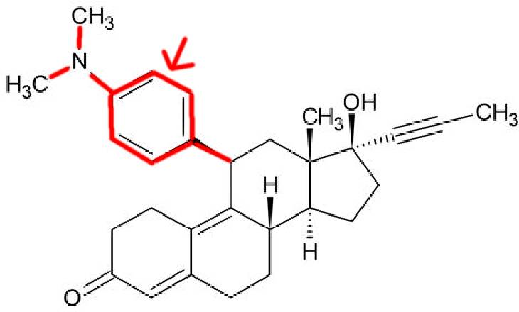
Mifepristone Chemical Structure
Progesterone backbone
with dimethyl-amino-benzene
added at the 11th position.
Chen, Jianzhong, et al. “The unique pharmacological characteristics of mifepristone (RU486): from terminating pregnancy to preventing cancer metastasis.” Med res reviews 34.5 (2014): 979-1000.
Copyright 2021 © Jeffrey Dach MD
Notes:
https://commons.wikimedia.org/wiki/File:Mifepristone.svg

Slide 29
Abortion Drug for “Somatic Pregnancy”
2021 Dr Liu:
“…Targeting the key events of somatic pregnancy is likely a better therapeutic strategy for cancer treatment than directly targeting cell mitotic proliferation (chemo), especially for those tumors with p53 inactivation.” (Liu, 2021)
Abort the “Somatic Pregnancy” !!
Liu, Chunfang, et al. "The Foundational Framework of Tumors: Gametogenesis, p53, and Cancer." Sem in Cancer Biology. 2021.
Old, Lloyd J. "Cancer is a somatic cell pregnancy." (2007).
Copyright 2021 © Jeffrey Dach MD
Notes:
Liu, Chunfang, et al. "The Foundational Framework of Tumors: Gametogenesis, p53, and Cancer." Seminars in Cancer Biology. Academic Press, 2021.

Slide 30
Complete Remission Leukemia
2014: Dr Jerome Check Cooper Inst., IND, Clinical Trial, Case Report:
Rapidly Advancing Lymphocytic Leukemia in Elderly Female.
Pt. Declined Chemotherapy.
Rx: Mifepristone 200 mg daily.
Achieves 12 month complete remission.
17) Check, Jerome H., et al. “Mifepristone Causing Complete Remission of Rapidly Advancing Leukemia with Measurement of Progesterone-induced Blocking Factor.” Anticancer res (2014) 2413.
Copyright 2021 © Jeffrey Dach MD
Notes:
Dr. Jerome Check’s group at the Cooper Institute for Reproductive Hormonal Disorders.

Slide 31
Advanced Lung Cancer
2016, Dr. Jerome Check Case Report:
Moribund Woman w/ Untreated Metastatic Lung Cancer, Given Mifepristone.
Regression of All Lung Lesions.
Remaining in Remission for Over 5 Years.
No Adverse Drug Effects. (23)
23) Check, Jerome H., et al. “Long-term high-quality survival with single-agent mifepristone treatment despite advanced cancer.” Anticancer Research 36.12 (2016): 6511-6513.
Copyright 2021 © Jeffrey Dach MD
Notes:
Dr. Jerome Check’s group at the Cooper Institute for Reproductive Hormonal Disorders.

Slide 32
Pancreatic CA / Osteosarcoma
2020, Dr. Check Case Reports:
Check, Jerome H., et al. "Treatment with mifepristone allows a patient with end-stage pancreatic cancer in hospice on a morphine drip to restore a decent quality of life." Anticancer Research 40.12 (2020): 6997-7001.
Check, Jerome H., et al. "Palliative Benefits of Oral Mifepristone for the Treatment of Metastatic Fibroblastic Osteosarcoma." Anticancer Research 41.4 (2021): 2111-2115.
Copyright 2021 © Jeffrey Dach MD
Notes:
Dr. Jerome Check’s group at the Cooper Institute for Reproductive Hormonal Disorders.

Slide 33
PIBF Breast Cancer Cell Study
2004 Dr Lachman: Studied PIBF in highly proliferating MCF-7 (breast cancer) cells.
PIBF mRNA overexpressed.
PIBF is associated with the Centrosome and Microtubule system.
Treatment with Nocodazole [5 μg/ml 4 hr]: “Disappearance of the Perinuclear PIBF dots, which Paralleled Disintegration of the Golgi Apparatus.”
24) Lachmann, Margit, et al. “PIBF (progesterone induced blocking factor) is overexpressed in highly proliferating cells and associated with the centrosome.” International journal of cancer 112.1 (2004): 51-60.
Copyright 2021 © Jeffrey Dach MD
Notes:
Benzimidazoles, including albendazole, fenbendazole, mebendazole, and nocodazole,

Slide 34
Mifepristone Unavailable, Try Mebendazole (Fenben)
Mifepristone Restricted, Unavailable?
Try Mebendazole (FenBen) (similar to Nocodazole), may also reduce PIBF.
Both are Microtubule Inhibitors.
Both Synergize with Autophagy Inhibitors.
Both Restore Anti-Tumor Immunity.
Lachmann, Margit, et al. “PIBF (progesterone induced blocking factor) is overexpressed in highly proliferating cells and associated with the centrosome.” Int J Cancer 112.1 (2004)
Copyright 2021 © Jeffrey Dach MD
Notes:
Benzimidazoles, including albendazole, fenbendazole, mebendazole, and nocodazole,

Slide 35
Evasion of Immune Surveillance
In 2019, Dr. Miao used Squamous Cell Cancer to study how cancer stem cells evade the immune system, finding that cancer stem cells acquire the CD80 surface protein, which directly blocks cytotoxic T cells from killing the cancer cells. (20)
20) Miao, Yuxuan, et al. “Adaptive immune resistance emerges from tumor-initiating stem cells.” Cell 177.5 (2019): 1172-1186.
Olivares, Enrique Ga, et al. "Cultured human decidual stromal cells express B7-1 (CD80) and B7-2 (CD86) and stimulate allogeneic T cells." Biology of reproduction 57.3 (1997): 609-615.
Copyright 2021 © Jeffrey Dach MD
Notes:
Benzimidazoles, including albendazole, fenbendazole, mebendazole, and nocodazole,

Slide 36
Evasion of Immune Surveillance Exosomal FOXP3 protein
2019, Dr. A. Dutta, Breast Cancer Stem Cells Generated Their Own Immunosuppressive T-Reg Cells by Secretion of Exosomes into TME containing FOXP3 protein, which binds to a Receptor on the T-Cell, which then Converts the T-Cell into an Immuno-Suppressive T-Reg Cell.(Dutta.2019)
Dutta A. A new insight into tumour immune-evasion: Crosstalk between cancer stem cells and T regulatory cells. Annals of Oncology. 2019 Nov 1;30
Eileen. “Trophoblast cells producing HCG promote conversion of CD4+ FOXP3− T cells into CD4+ FOXP3+ regulatory T cells and foster T cell suppressive activity." Biol Repro 94.5 (2016): 106
Copyright 2021 © Jeffrey Dach MD
Notes:
JEG-3 Trophoblast Cells Producing Human Chorionic Gonadotropin Promote Conversion of Human CD4+FOXP3− T Cells into CD4+FOXP3+ Regulatory T Cells and Foster T Cell Suppressive Activity1
Dr. Dutta studied
breast cancer stem cells and breast tumor tissues,
finding that the breast cancer stem cells
actually generated their own immunosuppressive
T-reg cells. This was done by secretion of
exosomes (small vesicles related to macropinocytosis)
into the micro-environment.
FOXP3 protein, which
binds to a receptor on the T cell, which then
converts the T cell into an immunosuppressive
T-reg cell.

Slide 37
Evasion of Immune Surveillance Exosomes
Both Cancer and Trophoblast Cells secrete Exosomes to Modulate T-Cell Signaling.
“These data suggest that tolerance induction may occur through the generation of exosomes, as also observed for pregnancy- and cancer-associated exosomes.” (Marleau, 2012)
Marleau, Annette M., et al. "Exosome removal as a therapeutic adjuvant in cancer." J of translational med 10.1 (2012): 1-12.
Copyright 2021 © Jeffrey Dach MD
Notes:
Pregnancy represents an in vivo example where exosomes promote immune tolerance to the “fetal allograft”. During pregnancy, local and systemic immune deviation occurs [38] and the failure to induce this “natural immune modulation” is associated with recurrent spontaneous abortions

Slide 38
Evasion of Immune Surveillance Cancer Stem Cells
2019, Dr. Alex Miranda studied 21 solid cancers, finding “stemness” to be associated with anti-cancer immunity.
“molecular pathways involving WNT/B-catenin,c-MYC…..have been implicated in the inhibition of antitumor immunity, yet they also play important roles in stem cell maintenance”
Miranda, Alex, et al. "Cancer stemness, intratumoral heterogeneity, and immune response across cancers." Proceedings of the National Academy of Sciences 116.18 (2019): 9020-9029.
Copyright 2021 © Jeffrey Dach MD

Slide 39
Immune Modulators
AHCC / Beta-Glucans
Artemisinin/ Artesunate
Celecoxib Cox-2 Inhibitor
Coley’s Toxins
Cimetidine H2R Antag, Antacid
DCA (All Glycolysis Inhibitors - Reduces Lactate in TME.)
Diclofenac NSAID
Dipyridamole
Iodine (Molecular)
LDN
Mebendazole
Metformin
Mifepristone (RU-486) Probiotics
Propranolol
Retinoids (Vitamin A, ATRA,
Accutane, Vesinoid)
Vitamin D3
Copyright 2021 © Jeffrey Dach MD

Slide 40
Restoring the Host Immune System
Coley’s Toxins (Bacterial)
RNA Viruses
The Mouse That Killed Cancer
Cimetidine
Beta Glucans
Others: D3, Iodine, LDN, etc.
Modern Immunotherapy, Check Point Inhib, Lenalidomide, CAR-T Therapy.
Copyright 2021 © Jeffrey Dach MD

Slide 41
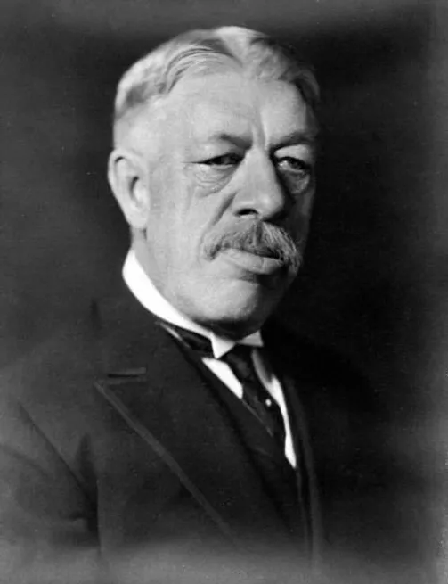
The Father of Immunotherapy
William Coley (1890–1936) New York Orthopedic Surgeon.
1891: Of 90 amputations for Osteosarcoma, only one survivor, pt contracted Erysipelas.
Coleys Toxins : Heat Killed Streptococcus pyogenes and Serratia marcescens.
1000 Pts. Injected, 150 papers.
1963 Banned by FDA, IND.
Photo courtesy of : https://www.biologicalmedicineinstitute.com/william-bradley-coley
Copyright 2021 © Jeffrey Dach MD
Notes:
previous 90 cases, revealing the only surviving
patient experienced complete tumor regression
after contracting erysipelas, a streptococcus
infection of the skin.

Slide 42
Wiliam Coley References
30) Coley, William B. “The Treatment of Inoperable Sarcoma with the Mixed Toxins of Erysipelas and Bacillus Prodigiosus: One Hundred and Forty Cases.” Journal of the American Medical Association 31.9 (1898): 456-465.
31) Coley, William B. “The treatment of inoperable sarcoma by bacterial toxins (the mixed toxins of the Streptococcus erysipelas and the Bacillus prodigiosus).” Proc Royal Society of Medicine 3.Surg_Sect (1910): 1-48.
Coley, William B. "The Classic: The Treatment of Malignant Tumors by Repeated Inoculations of Erysipelas: With a Report of Ten Original Cases." Clinical Orthopaedics and Related Research (1976-2007) 262 (1991): 3-11.
Copyright 2021 © Jeffrey Dach MD

Slide 43
RNA Viruses with Anti-Cancer Activity
Mumps
Newcastle disease virus
Measles virus
Vesicular stomatitis virus
Influenza,
Reovirus, and
Poliovirus.
Russell, Stephen J. "RNA viruses as virotherapy agents." Cancer gene ther (2002): 961-966.
Copyright 2021 © Jeffrey Dach MD

Slide 44
Regression of Cancer with Measles Refs
Bluming, AvrumZ,"Regression of Burkitt's lymphoma in association with measles infection." Lancet 298.7715 (1971): 105-106
Grote, Deanna, "Live attenuated measles virus induces regression of human lymphoma xenografts in immunodeficient mice." Blood 97.12 (2001): 3746-3754.
Grote, Deanna"Neutrophils contribute to the measles virus-induced antitumor effect: enhancement by granulocyte macrophage colony-stimulating factor expression." Can res 63.19 (2003):
Peng, Kah-Whye, et al. "Systemic therapy of myeloma xenografts by an attenuated measles virus." Blood, 98.7 (2001): 2002-2007.
Peng, Kah-Whye, et al. "Intraperitoneal therapy of ovarian cancer using an engineered measles virus." Can res 62.16 (2002)
McDonald, Cari J., "A measles virus vaccine strain derivative as a novel oncolytic agent against breast cancer." Breast cancer res and treat 99.2 (2006): 177-184.
Copyright 2021 © Jeffrey Dach MD
Notes:
A complete regression of histologically diagnosed Burkitt's lymphoma in an untreated African boy was observed following an attack of measles. The tumour, of 6 months duration, involved the right orbit. Measles developed shortly after the biopsy, and the tumour was noted to be regressing on the first day of the exanthem. It disappeared within 2 weeks and showed no sign of recurrence 4 months later. Skin testing with a variety of antigens gave negative results on 2 occasions. Dinitrochlorobenzene sensitization proved unsuccessful.
Measles is known to suppress reactivity to tuberculin, and might therefore be expected to have an adverse rather than a beneficial effect on the course of a lymphoma. There have however been reports of regression in acute lymphoblastic lymphoma following measles. Some possible immunological mechanisms are discussed. D. S. Ridley.

Slide 45
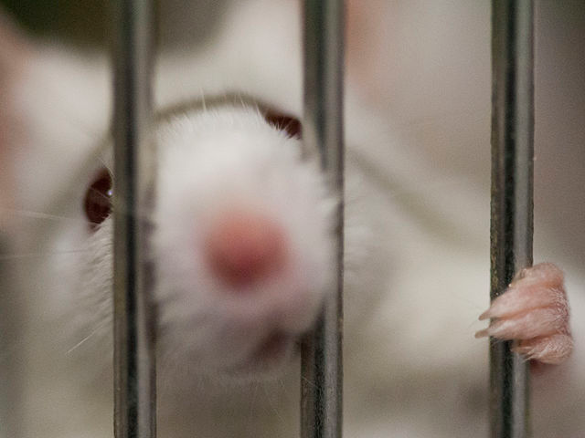
The Mouse that Killed Cancer
Mouse Sarcoma
S180-Induced Ascites: one of the most aggressive transplantable cancers in experimental mouse models.
https://commons.wikimedia.org/wiki/File:Mouse_in_a_cage.jpg
Notes:
File:Mouse in a cage.jpg
Mouse sarcoma S180-induced ascites represents one of the most aggressive transplantable cancers in experimental mouse models.
https://commons.wikimedia.org/wiki/File:Mouse_in_a_cage.jpg

Slide 46
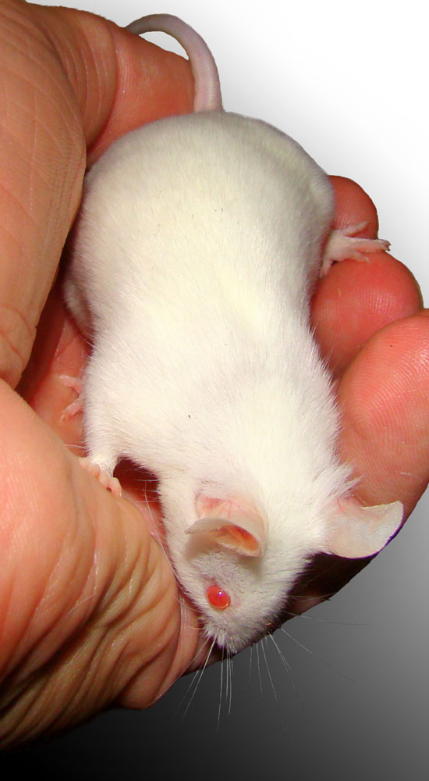
The SR/CR Mouse
“The Mouse that Killed Cancer.”
2003, Wake Forest Med School in N. Carolina.
Innate T-Cell Immunity to Cancer.
Genetic Trait.
Immunity Transferable to Wild Mice by Transfusing T Cells from SR/CR Mouse.
Copyright 2021 © Jeffrey Dach MD
Notes:
https://commons.wikimedia.org/wiki/File:White_lab_mouse_in_hand_BW.jpg
Mouse sarcoma S180-induced ascites represents one of the most aggressive transplantable cancers in experimental mouse models.
Spontaneous regression/complete resistance
Over the next 3 years, studies showed this
strain of mice had an innate immunity to cancer,
a genetic trait passed on to the offspring.
Their T lymphocytes (T Cells), recognized and
killed the cancer cells, just as if cancer were
an invading microorganism. These mice were
called SR/CR mice, which stands for spontaneous
regression/complete resistance to cancer.
(2)
protection from
the injected cancer cells could be transferred to
plain mice after transfusion with T cells from
SR/CR mice.

Slide 47
SR/CR Mouse References
1) Cui, Zheng, “Spontaneous regression of advanced cancer: a genetically determined, age-dependent trait in mice.” Proc Nat Acad Sci 100.11 (2003): 6682-6687.
2) Hicks, Amy M., et al. “Effector mechanisms of the anti-cancer immune responses of macrophages in SR/ CR mice.” Cancer Immunity Archive 6.1 (2006): 11.
3) Hicks, Amy M.“Transferable anticancer innate immunity in spontaneous regression/complete resistance mice.” Proc Nat Acad of Sci 103.20 (2006): 7753-7758.
4) Stehle, John R.“Impact of sex, MHC, and age on the therapeutic effect of transferred leukocytes from cancer-resistant SR/CR mice.” BMC cancer 9.1 (2009): 328.
Copyright 2021 © Jeffrey Dach MD
Notes:
Over the next 3 years, studies showed this
strain of mice had an innate immunity to cancer,
a genetic trait passed on to the offspring.
Their T lymphocytes (T Cells), recognized and
killed the cancer cells, just as if cancer were
an invading microorganism. These mice were
called SR/CR mice, which stands for spontaneous
regression/complete resistance to cancer.
(2)
protection from
the injected cancer cells could be transferred to
plain mice after transfusion with T cells from
SR/CR mice.

Slide 48
Cimetidine H2 R Blocker
1970 Discovered by Smith Kline & French.
1979 Tagamet © FDA approved for Heartburn and Gastric Ulcer.
Binds to H2 Receptors in Parietal Cells of Stomach, Blocks Gastric Acid Secretion.
1989 World No. 1 Drug, 1 Billion in sales.
Now OTC, replaced by PPI’s.
Unexpectedly Found to Stimulate Host Immune Cell Expansion, and Reverse Tumor Immune Evasion.
Case Reports of Cancer Remission (G Lymphoma)
Copyright 2021 © Jeffrey Dach MD
Notes:
Ten years after its introduction, it had achieved sales of one billion dollars and had become the world's number one prescription drug.
FDA-approved in 1979 as histamine receptor
blocker (H2 receptor), cimetidine (Tagamet®)
was originally marketed as an antacid drug for
treatment of gastric hyperacidity, gastritis, and
ulcer. Cimetidine inhibits gastric acid secretion
by binding to the H2 receptors in parietal cells
in the gastric wall. In its day, cimetidine was
a top-selling drug and today is still available
over the counter. For the most part, cimetidine
has been replaced by the newer proton pump
inhibitor antacids (PPI drugs). Doctors using
cimetidine observed remarkable cancer regressions
that seemingly involved the drug’s ability
to stimulate host immune cell expansion and
reverse immune tumor evasion

Slide 49
Cimetidine (Tagamet) MOA
In 2006, Dr. Takahashi :PBMC 10 volunteers.
via H2R, CIM induces IL-18 Production in Monocytes.
Interleukin-18 (IL-18) is an Immuno-Stimulatory Cytokine with Anti-Cancer Activity. (Takahashi, 2006)(Xiong, 2019)
Takahashi, Hideo “Cimetidine induces interleukin-18 production through H2-agonist activity in monocytes.” Molec pharm 70.2 (2006): 450-453.
Xiong, Donglan, et al. "Antitumor activity of interleukin-18 on A549 human lung cancer cell line." J of cancer research and therapeutics 15.7 (2019): 1635.
Copyright 2021 © Jeffrey Dach MD

Slide 50
Cimetidine Anti-Histamine Anti-Cancer Effects
2014, Dr. Pan Pantziarka Review:
Immuno-Modulatory. Increased NK Cells, Reduced T Reg. Shift T2 to T1.
Anti-Proliferative.
Anti-Angiogenic Effects.
Inhibition of Tumor Cell Adhesion.
24) Pantziarka, Pan,“Cimetidine as an anti-cancer agent.”(2014).
25) Kubecova, M “Cimetidine: An anticancer drug?” Euro J Pharm Sci 42.5 (2011): 439-444.
26) Lefranc, F Cimetidine for glioblastoma. Int j onc 28.5 2006 ,1021.
Copyright 2021 © Jeffrey Dach MD
Notes:
Cimetidine (CIM) is a histamine H2-receptor antagonist (H2RA), in the same class as ranitidine, famotidine, and nizatidine
Antiproliferative: Oral cimetidine blocks
histamine stimulated growth of colon cancer
cells in a mouse model.
Histamine is associated with an immunosuppressive
tumour micro-environment
[TME], including increased regulatory T
cell [T-reg] activity, reduced antigen-presenting
activity of dendritic cells [DC],
reduced NK-cell activity and increased
myeloid-derived suppressor cell [MDSC]
activity…. histamine binding to the H2
receptor is associated with suppression
of IL-12 and stimulation of IL-10 secretion
and is implicated with a shift in Th1/Th2
balance toward Th2-dominance of the
immune response. This effect was reversed
by CIM [Cimetidine] in human PBMC
[peripheral blood monocytes]
MDSCs
[myeloid-derived suppressor cells] express
H1–H3 receptors, and there is in vitro and
in vivo evidence that blockade of H1 [using
the H1RA cetirizine] or H2 [using CIM], can
reverse the immunosuppressive action of
these cells … An increase in NK activity
compared to non-CIM-treated controls has
also been noted in cardiopulmonary bypass
surgery. (24)

Slide 51
Cimetidine Cancer Cell Types Studied
Remission in Gastric Lymphoma Case Reports (Strauchen, 1987)
Remission in Leukemia CR (Ankerst, 1984)
Renal Cell Cancer 2 Complete Remissions lasting 26 and 33+ months, 38 pts treated.(Inhorn, 1992)
Lung Cancer (Zheng, 2013)
Ovarian Cancer (Kikuchi,1985) Mouse Xeno.
Many Clin Trials: Gastric CA, Colon CA, Melanoma, Metastatic renal CA (Lefranc, 2006)
Glioblastoma (In vivo in vitro) (Lefranc, 2006)
Copyright 2021 © Jeffrey Dach MD

Slide 52
Cimetidine References
1) Strauchen, James A., et al. “Spontaneous regression of gastric lymphoma.” Cancer 60.8 (1987): 1872-1875.
2) Ankerst, Jaro, et al. “Complete remission in patient with acute myelogenous leukemia treated with leukocyte α-interferon and cimetidine.” Cancer Imm, Immunotherapy 17.1 (1984): 69-71.
3) Inhorn, L., et al. “High-dose cimetidine for the treatment of metastatic renal cell carcinoma. A Hoosier Oncology Group study.” American journal of clinical oncology 15.2 (1992): 157-159.
6) Lefranc, Florence “Cimetidine, unexpected anti-tumor agent, for the treatment of glioblastoma.” Int j of onc 28.5 (2006): 1021-1030.
7) Zheng, Yisheng, et al. “Cimetidine suppresses lung tumor growth in mice through proapoptosis of myeloid-derived suppressor cells.” Molecular immunology 54.1 (2013): 74-83.
12) Kikuchi, Yoshihiro, et al. “Effects of cimetidine on tumor growth and immune function in nude mice bearing human ovarian carcinoma.” J of Nat Cancer Inst 74.2 (1985): 495-498.
Copyright 2021 © Jeffrey Dach MD
Notes:
The Hoosier Oncology Group evaluated cimetidine in 42 patients with metastatic renal cell carcinoma. There were two complete remissions that lasted for 26 and 33+ months in 38 evaluable patients. There were no partial remissions. Toxicity was minimal. Patients with renal cell carcinoma can occasionally respond to cimetidine with long-term remission.
FDA-approved in 1979 as histamine receptor
blocker (H2 receptor), cimetidine (Tagamet®)
was originally marketed as an antacid drug for
treatment of gastric hyperacidity, gastritis, and
ulcer. Cimetidine inhibits gastric acid secretion
by binding to the H2 receptors in parietal cells
in the gastric wall. In its day, cimetidine was
a top-selling drug and today is still available
over the counter. For the most part, cimetidine
has been replaced by the newer proton pump
inhibitor antacids (PPI drugs). Doctors using
cimetidine observed remarkable cancer regressions
that seemingly involved the drug’s ability
to stimulate host immune cell expansion and
reverse immune tumor evasion

Slide 53
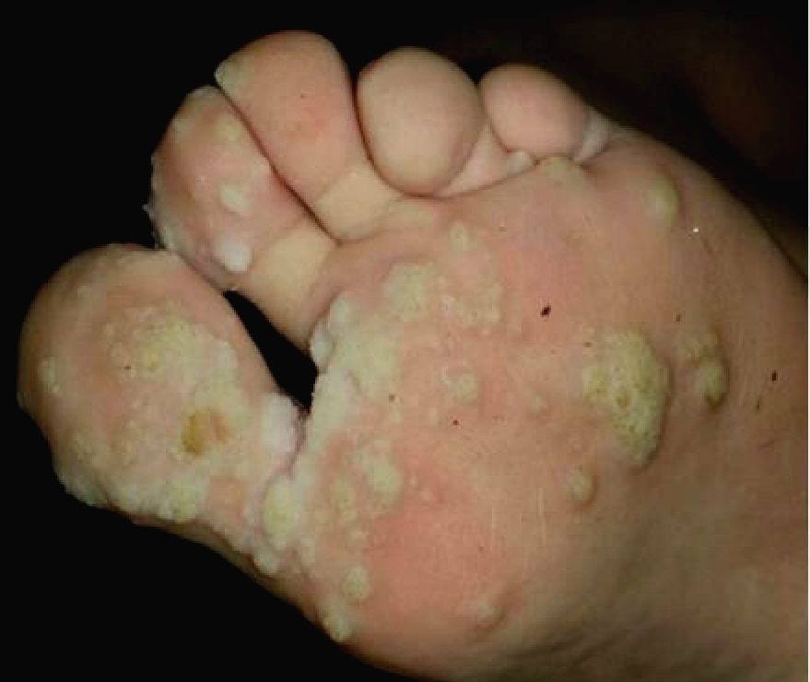
Notes:
Cimetidine for Cutaneous Warts (HPV)— Enhancing Cell-Mediated Immunity

Slide 54
Cimetidine for Cutaneous Warts (HPV)— Enhancing Cell-Mediated Immunity
2018, Das: 8 Pediatric Heart Transplant Pts Multiple Cutaneous Warts (HPV).
All Immunosuppressed with Tacrolimus, (Mycophenolate or AZT).
7 of 8 Had Complete Remission with CIM.
Safe to use High Dose Cimetidine (30–40 mg/kg/day) in 2 divided doses for 5–6 months.
Das, B “Cimetidine for cutaneous warts in pediatric heart transplant recipients.” Med Sci 6.2 (2018): 30.
Copyright 2021 © Jeffrey Dach MD
Notes:
Cimetidine for Cutaneous Warts (HPV)—Enhancing Cell-Mediated Immunity
Cimetidine is postulated to act as an immunomodulatory agent at high doses by inhibiting suppressor T-cell function [15]. The paradigm between T helper (Th) 2 cells, and Th1 cells predominance is reflected in the level of cytokines that are released. Cimetidine activates Th1 cells to produce interleukin (IL)-2, IL-12, tumor necrosis factor (TNF)-α, and interferon (IFN)-γ and their expression correlates with improvement in cellular immunity and wart remission [16,17]. Patients who received cimetidine were shown to exhibit enhanced cell-mediated immunity,

Slide 55
Cimetidine for Herpes Viruses
29) Kapińska-Mrowiecka, M. Efficacy of cimetidine in treatment of Herpes zoster in the first 5 days Polski tygodnik lekarski (1996
30) Komlos, Luise, et al. “In vitro cell-mediated immune reactions in herpes zoster patients treated with cimetidine.” Asian Pacific journal of allergy and immunology 12 (1994): 51-51.
33) Hayne, S. T.“Herpes zoster: treatment w cimetidine.” Can Medical Association Journal 129.12 (1983): 1284.
34) Cohen, Philip “Herpes simplex virus infections and cimetidine therapy.” J of the Amer Acadof Derm 19.4 (1988): 762-763.
35) Kurzrock, R “Cimetidine therapy of herpes simplex virus infections in immunocompromised patients.” Clinical and experimental dermatology 12.5 (1987): 326-331.
36) Levy, D. W., “Cimetidine in the treatmentof herpes virus infections.” South African medical journal 58.3 (1980): 112-116.
37) Wakefield, Denis. “Cimetidine in recurrent genital
herpes simplex infection.” Ann of internal med 101.6 (1984): 882
Copyright 2021 © Jeffrey Dach MD
Notes:
Cimetidine for Cutaneous Warts (HPV)—
Enhancing Cell-Mediated Immunity

Slide 56
Cimetidine Adverse Effects
Inhibitor of Cytochrome P450.
Most common AEs: headache, dizziness, diarrhea, and rash.
Rare (at high doses): Gynecomastia, Reversible Impotence. Leukopenia.
Malabsorption of B12, Fe and Ca+2 from Prolonged Suppression of Gastric Acid.
Pantziarka, P "(ReDO)—Cimetidine as an anti-cancer agent.“ Ecancermedicalscience 8 (2014).
Copyright 2021 © Jeffrey Dach MD
Notes:
CIM has low toxicity, with the most common
side effects being headache, dizziness,
diarrhea, and rash. Rare side effects include
gynecomastia, reversible impotence
(particularly reported in patients receiving
very high doses) … Rarely, CIM has also
been associated with reversible leukopenia
and thrombocytopenia, effects that may
be particularly important to watch for in
cancer patients who may be undergoing
chemotherapy…. CIM is an inhibitor of
cytochrome P450, through multiple [CYP]
enzymes.

Slide 57
Cimetidine / Mebendazole
1987, Dr. Bekhti: 3 pts w/ Hepatic Echinococcal cyst.
Mebendazole (1.5 Grams TID x 30 Days)
CIM (1200 mg/day x 30 Days),
1 Hr Serum Conc. of MB Doubled.
Complete Resolution of the previously unresponsive liver cysts.
38) Bekhti, A., Cimetidine increases serum mebendazole concentrations in treatment of hepatic hydatid cysts.” Brit j clin pharm 24.3 (1987): 390-392.
Copyright 2021 © Jeffrey Dach MD

Slide 58
Dietary Beta Glucans
Edible Mushrooms, Reishi, Maitake, and Shiitake.
Baker’s Yeast and Cereals .
PAMPS- Pathogen Associated Molecular Patterns (Long Chains of Polysaccharides).
Immune Stimulating Effects.
Replacement for Coley’s Toxins ?
Del Cornò, “Shaping the Innate Immune Response by Dietary Glucans Any Role in Control of Cancer?. Cancers 12.1 (2020) 155.
Copyright 2021 © Jeffrey Dach MD
Notes:
dietary beta glucans, a group of plant polysaccharides
(sugars) found in edible mushrooms,
baker’s yeast, and cereals in the diet since
ancient times. Mushrooms used for beta glucan
extraction include reishi, maitake, and shiitake.
(PAMPs). These are molecules in
the cell wall of pathogenic yeasts and bacteria
that “strongly contribute to microorganism
recognition and clearance.” In other words, the
beta glucans have molecular structures that
“mimic” pathogenic organisms recognized by
our immune system, which then stimulate an
immune response.
In vitro studies have shown that Beta-
Glucans from yeasts, mushrooms or cereals
are able to enhance the responsiveness or
function of human primary immune cells,
eliciting potent immune responses … the
immune stimulating effects of Beta Glucans
can be elicited in a wide variety of species,
including earthworms, insects, shrimp,
birds, mammals and humans. (19–24)

Slide 59
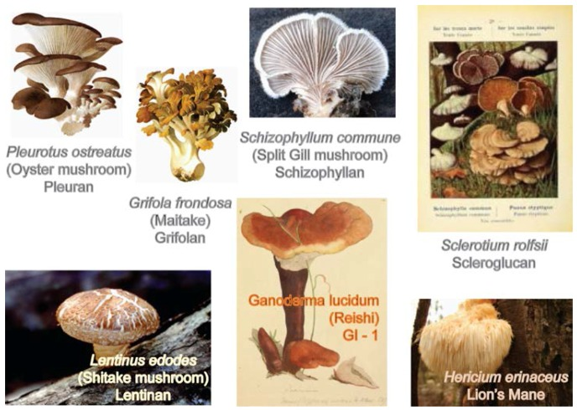
Mushrooms Containing β-glucans
Notes:
Mushrooms containing β-(1→3)-glucans with β-(1→6) branching).
https://commons.wikimedia.org/wiki/Category:Beta-glucans#/media/File:Mushrooms-containing--13-glucans-with--16-branching.jpg
Mendel Friedman - Mendel Friedman. "Mushroom Polysaccharides: Chemistry and Antiobesity, Antidiabetes, Anticancer, and Antibiotic Properties in Cells, Rodents, and Humans ," Foods doi:10.3390/foods5040080

Slide 60
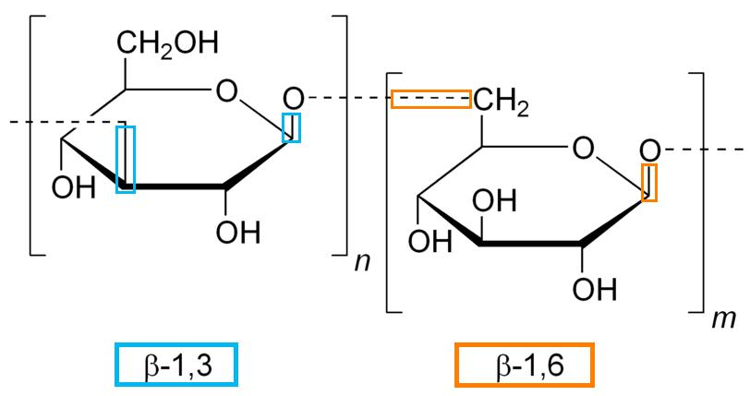
β-Glucans – Polysaccharide Chains
https://commons.wikimedia.org/wiki/Category:Beta-glucans#/media/File:BetaGlucanGuide.jpg
Notes:
Reference showing different glycosidic bonds of a beta-glucan.
https://commons.wikimedia.org/wiki/Category:Beta-glucans#/media/File:BetaGlucanGuide.jpg

Slide 61
AHCC Prostate CA Case Report
2009, Dr. Jeffrey Turner: 66-year-old Male with Metastatic Prostate Cancer.
PSA 2,000 w/ Blastic Mets to LS Spine, L Hip Pain
Rx Androgen Blockade , after 4 Mo., PSA =4
Rx DC’d, then after 10 Mo, PSA = 69.
AHCC started by pt., PSA dropped to 1.5, Stable disease, improved ambulation.
Turner, J Dramatic PSA response with activated hemicellulose compound in metastatic castration-resistant prostate cancer.” Anti-cancer drugs 20.3 (2009)
Copyright 2021 © Jeffrey Dach MD

Slide 62
Fifth Pillar
Upregulation Inflammatory Pathways
NF-kB, IL-6, COX-2, 5-LOX
Notes:
https://commons.wikimedia.org/wiki/File:Corinthian_Column_of_the_Temple_of_Zeus_in_Athens.jpg
Of equal importance are fourth and fifth
factors, the cancer cell’s escape from immune
surveillance, and upregulation of inflammation.
Immunologic phases of pregnancy
Each stage of pregnancy is characterized by a unique inflammatory environment. The first and third trimesters are proinflammatory (TH1), whereas the second trimester represents an anti-inflammatory phase also knowns and TH2 environment.
Mor, Gil, et al. "Inflammation and pregnancy: the role of the immune system at the implantation site." Annals of the new York Academy of Sciences 1221.1 (2011): 80.

Slide 63
NF-kB Inhibitors
Artemisinin/Artesunate
Aspirin
Azithromycin
Baicalein Chinese Skullcap
Berberine
Boswellia (Frankincense)
CBD Cannabidiol
Clarithromycin
Curcumin
Doxycycline Potent Inhibitor
Fenofibrate
Ivermectin
Mefloquine
Niclosamide
Parthenolide (Feverfew)
Pterostilbene
Statin Drugs
Sulfasalazine
Sulforaphane
Thymoquinone
Copyright 2021 © Jeffrey Dach MD
Notes:
Reprinted from the Quick Refence Guide Cracking Cancer Toolkit

Slide 64
COX-2 Inhibitors
Regulation of COX-2 Protein Expression is Downstream to the Nuclear Factor Kappa B pathway.
Aspirin Irreversible Inhibitor of COX-1 and COX-2
Celecoxib COX-2 Inhibitor
Diclofenac Nonspec COX Inhib, c-Myc and Glycolysis)
Sulindac Nonspecific COX Inhibitor, suppresses 5-LOX
Dipyridamole (Inhib NF-kB, and then COX2).
Park, Mi Hee, "Roles of NF-κB in cancer and inflammatory diseases and their therapeutic approaches." Cells 5.2 (2016): 15.
St-Germain, Marie-Eve “Regulation of COX-2 protein expression by Akt in endometrial cancer cells is mediated through NF-κB/IκB pathway.” Molecular Cancer 3.1 (2004): 7.
Copyright 2021 © Jeffrey Dach MD
Notes:
Aspirin Irreversible Inhibitor of COX-1 and COX-2
Celecoxib COX-2 Inhibitor
Diclofenac Nonspecific COX Inhibitor
Dipyridamole
Sulindac Nonspecific COX inhibitor, suppresses
5-LOX.

Slide 65
Celecoxib COX-2 Inhibitor
1998 FDA-approved for rheumatoid arthritis and osteo-arthritis.
1999 for prevention of FAP (familial adenomatous polyposis) precursor for colon cancer.
2005 for ankylosing spondylosis
2006 for juvenile rheumatoid arthritis.
Hashemi Goradel, Nasser, et al. “Cyclooxygenase‐2 in cancer: A review.” Journal of cellular physiology 234.5 (2019): 5683-5699.
Copyright 2021 © Jeffrey Dach MD

Slide 66
Celecoxib COX-2 Inhibitor
Very Useful as Adjuvant with Chemotherapy and/or Radiotherapy. (Hashemi, 2019)
Very Useful in Hematologic Cancers which Upregulate COX2. Bernard 2008
Useful in Breast Cancer (Shaashua, 2017)
Hashemi Goradel, Nasser, et al. “Cyclooxygenase‐2 in cancer: A review.” Journal of cellular physiology 234.5 (2019): 5683-5699.
Bernard, M. P., et al. “Targeting cyclooxygenase-2 in hematological malignancies: rationale and promise.” Current pharmaceutical design 14.21 (2008): 2051-2060.
Shaashua, Lee, et al. "Perioperative COX-2 and β-adrenergic blockade improves metastatic biomarkers in breast cancer patients in ph-II randomized trial." Clin Can Res (2017): 4651-4661.
Copyright 2021 © Jeffrey Dach MD

Slide 67
Celecoxib Anti-Cancer Effects
1) Inhibition of Angiogenesis by reducing VEGF [Vascular Endothelial Growth Factor]
2) Reduces invasion by reduction in MMP [Matrix Metallo-Proteinase]
3) Inhibition of proliferation by reduction in NF-kB, STAT3, MEK and Cyclins, Upregulation of p27 [tumor suppressor gene].
Bernard, M. P., et al. “Targeting COX-2 in hematological malignancies.” Curr pharm design 14.21 (2008): 2051-2060.
Copyright 2021 © Jeffrey Dach MD
Notes:
The mitogen-activated extracellular signal-regulated kinase (MEK) pathway is one of the best-characterized kinase cascades in cancer cell biology. It is triggered by either growth factors or activating mutations of major oncogenic proteins in this pathway, the most common being Ras and Raf.

Slide 68
Celecoxib Anti-Cancer Effects
4) Impairs survival by Downregulating BCL-2 [anti-apoptotic protein], NF-kB, Glutathione, AKT, increasing reactive oxygen species (ROS), Caspase Activity.
5) Significantly Attenuates Glutathione Levels.
6) Enhances Host Immune Function.
7) Reduced T-Reg Cells [immunosuppressive cells]. (Bernard, 2008)
Bernard, M. P “Targeting cyclooxygenase-2 in hematological malignancies (2008): 2051-2060.
Copyright 2021 © Jeffrey Dach MD

Slide 69
Celecoxib COX2 Inhibitor
Dr Sareddy 2013: Glioblastoma Cells:
Celecoxib Targets Cancer Stem Cells, Wnt/Beta Catenin/TCF Pathway.
Sareddy, Gangadhara Reddy, et al. “Nonsteroidal anti-inflammatory drugs diclofenac and celecoxib attenuates Wnt/β-catenin/Tcf signaling pathway in human glioblastoma cells.” Neurochemical research 38.11 (2013): 2313-2322.
21) Maier, Thorsten Jürgen, et al. “Targeting the Beta-Catenin/APC pathway: a novel mechanism to explain the cyclooxygenase-2-independent anticarcinogenic effects of celecoxib in human colon
carcinoma cells.” The FASEB journal 19.10 (2005): 1353-1355.
Copyright 2021 © Jeffrey Dach MD

Slide 70
Celecoxib PI3K/Akt/mTOR
Celecoxib Blocks the phospho-inositol-kinase-Akt/mTOR (PI3K/Akt/mTOR) pathway, a “master regulator” for cancer cell survival, growth, and proliferation,
Also a CSC pathway.
Note: All OXPHOS Inhibitors are Wnt/CSC pathway inhibitors. All OXPHOS inhibitors also Inhibit mTOR, Inducing “Protective Autophagy.”
Copyright 2021 © Jeffrey Dach MD

Slide 71
Celecoxib PI3K/Akt/mTOR REF.
34) Hsu, Ao-Lin, “The COX-2 inhibitor celecoxib induces apoptosis by blocking Akt activation in human prostate cancer cells independently of Bcl-2.” J Biol Chem (2000):
35) Liu, Min,“Celecoxib regulates apoptosis and autophagy via PI3K/Akt signaling pathway in gastric cancer cells.” Int j mol med 33.6 (2014): 1451-1458.
36) Leng, Jing, et al. “COX-2 promotes hepatocellular carcinoma cell growth through Akt activation: evidence for Akt inhibition in celecoxib induced apoptosis.” Hepatology 38.3 (2003): 756-768.
37) Glynn, Sharon A.,“COX-2 activation is associated with Akt phosphorylation and poor survival in ER-neg, HER2-pos breast cancer.” BMC cancer 10.1 (2010)
Setia, Shruti. "The PI3K/Akt pathway in colitis associated colon cancer and its chemoprevention with celecoxib, a Cox-2 selective inhibitor." Biomed & Pharm 68.6 (2014): 721-727.
Copyright 2021 © Jeffrey Dach MD

Slide 72
Quercetin - Natural PI3K/Akt/mTOR Inhibitor
Granato, Marisa, "Quercetin induces apoptosis and autophagy in primary effusion lymphoma cells by inhibiting PI3K/AKT/mTOR and STAT3 signaling pathways." The J nut biochem 41 (2017): 124-136.
Jia, Lijun, et al. "Quercetin suppresses the mobility of breast cancer by suppressing glycolysis through Akt-mTOR pathway mediated autophagy induction." Life sciences 208 (2018): 123-130.
Song, Jing, et al. "Effects of Quercetin on Autophagy and Phosphatidylinositol 3-kinase/Protein Kinase B/Mammalian Target of Rapamycin Signaling Pathway in Human Prostate Cancer PC-3 Cells." Acta Academiae Medicinae Sinicae 42.5 (2020): 578-584.
Li, Xiuli, et al. "Quercetin suppresses breast cancer stem cells (CD44+/CD24−) by inhibiting the PI3K/Akt/mTOR-signaling pathway." Life sciences 196 (2018): 56-62.
Granato, Marisa “Reduction of c-Myc expression and PI3K /AKT/mTOR signaling by Quercetin induces strong cytotoxic effect against Burkitt’s lymphoma." Int j biochem cell biology (2016): 393
Copyright 2021 © Jeffrey Dach MD

Slide 73
Celecoxib Synergies w/
Atorvastatin
Auranofin
Curcumin
Metformin
Quercetin
Tocotrienol
Copyright 2021 © Jeffrey Dach MD

Slide 74
Celecoxib Synergies refs
Yu, C.-P. Celecoxib and quercetin induce apoptosis in human hepatocarcinoma. Biomed. Res. 2017, 28, 3465–3470
Shirode, Amit B. "Synergistic anticancer effects of combined γ-tocotrienol and celecoxib associated with suppression in Akt and NFκB signaling." Biomed & Pharmacother 64.5 (2010): 327-332.
Hu, Jun-Wen, et al. "Novel combination of celecoxib and metformin improves the antitumor effect by inhibiting the growth of Hepatocellular Carcinoma." Journal of Cancer 11.21 (2020): 6437.
Han, Yi, et al. "Synergy between auranofin and celecoxib against colon cancer in vitro and in vivo through a novel redox-mediated mechanism." Cancers 11.7 (2019): 931.
Xiao, Hang, "Combination of atorvastatin and celecoxib synergistically induces cell cycle arrest and apoptosis in colon cancer cells." Int j cancer 122.9 (2008)
Lev-Ari, Shahar, et al. "Celecoxib and curcumin synergistically inhibit the growth of colorectal cancer cells." Clinical Cancer Research 11.18 (2005): 6738-6744.
Alqahtani, A. M., "Curcumin-Celecoxib: a synergistic and rationale combination chemotherapy for breast cancer." Europ rev med and pharma sci 25.4 (2021
Copyright 2021 © Jeffrey Dach MD

Slide 75
Celecoxib w/ Chemo: Curative Efficacy
2011 Dr Jin, and 2016, Dr. Lisa Pang:
COX-2 plays an important role in CSC survival and repopulation of CSCs after chemotherapy.
Inhibition of COX-2 prevents this chemotherapy induced cancer stem cell survival and repopulation, potentially leading to “Curative Efficacy”.
Jin, C. H. "Observation of curative efficacy following combination chemotherapy with celecoxib in advanced colorectal cancer." J of Int Med Res 39.6 (2011
Pang, Lisa Y., “Cyclooxygenase-2: a role in cancer stem cell survival and repopulation of cancer cells during therapy.” Stem cells int (2016).
Copyright 2021 © Jeffrey Dach MD
Notes:
Drs. Lisa Pang et al. report (2016) that
COX-2 plays an important role in CSC survival
and repopulation of CSCs after chemotherapy.
Inhibition of COX-2 prevents this chemotherapy
induced cancer stem cell survival and
repopulation, potentially leading to “curative
efficacy”. (55A)

Slide 76
Celecoxib Adverse Effects
CardioVascular: Increased risk of myocardial infarction and stroke.
GI Bleeding. (All NSAIDS)
Reduces serum testosterone by reducing prostaglandin synthesis in testicular Leydig cells.
Pang, Lisa Y., “Cyclooxygenase-2: a role in cancer stem cell survival
and repopulation of cancer cells during therapy.” Stem cells international 2016 (2016).
Copyright 2021 © Jeffrey Dach MD
Notes:
Drs. Lisa Pang et al. report (2016) that
COX-2 plays an important role in CSC survival
and repopulation of CSCs after chemotherapy.
Inhibition of COX-2 prevents this chemotherapy
induced cancer stem cell survival and
repopulation, potentially leading to “curative
efficacy”. (55A)

Slide 77
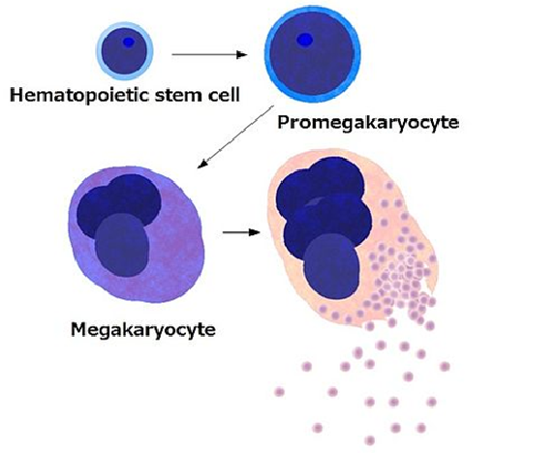
Platelets Budding Off Megakaryocytes
Platelets
Platelets by budding off from megakaryocytes.jpg
Copyright 2021 © Jeffrey Dach MD
Notes:
Platelets by budding off from megakaryocytes.jpg

Slide 78
Platelets are Functional Players in Cancer
Thrombocytosis >400,000 (poor prognosis).
Cancer secretes IL-6, Stimulates Liver to make TPO (Thrombopoetin), Increases platelet count.
“Platelets are … functional players in primary tumor growth and in all steps of the metastatic process. They infiltrate into the TME to directly interact with cancer cells. In the circulation, platelets protect CTCs from the deadly attack of the immune system…” (Haemmerle, 2018)
10) Haemmerle, Monika, et al. “The platelet lifeline to cancer: challenges and opportunities.” Cancer Cell (2018): 965-983.
Copyright 2021 © Jeffrey Dach MD
Notes:
10) Haemmerle, Monika, et al. “The platelet lifeline
to cancer: challenges and opportunities.” Cancer Cell
33.6 (2018): 965-983.
exhibit elevated
platelet counts—over 400,000 on the
automated blood count test (CBC). This condition,
called thrombocytosis, is associated with
poor prognosis and reduced survival. About
40% of patients screened for thrombocytosis
will harbor underlying malignancy. (8–9)

Slide 79
Platelets Facilitate Cancer
Oncology Ignores the Role of Platelets.
Sports Medicine: PRP for Sports Injuries.
Cancer Uses Platelets for Growth Factors.
PDGF= platelet-derived growth factor,
VEGF= vascular endothelial growth factor
TGF-β = Transforming Growth Factor Beta.
Platelet Inhibitors = Dipyridamole , ASA
5) Carrillo-Mora, Paul, et al. “Platelets-rich plasma: a versatile tool for regenerative medicine.” Cir Cir 81.1 (2013): 74-82.
6) Mishra, Allan, et al. “Sports medicine applications of platelet rich plasma.” Current pharmaceutical biotechnology 13.7 (2012): 1185-1195.
Copyright 2021 © Jeffrey Dach MD
Notes:
Clopidogrel Plavix

Slide 80
Natural Anti-Platelet Agents Pt Must be Off x 1 Wk before Surgery
Baicalein (Chinese Skullcap)
Berberine
Boswellia (Frankincense)
Cordyceps
Curcumin
EGCG
Garlic (Allicin)
Oregano (carvacrol/thymol)
Pterostilbene (Methylated Resveratrol)
Quercetin
Sulforaphane
Thymoquinone
Others (Fish Oil, Vit E)
Elisa Hirsch, Gabriela, et al. "Natural products with antiplatelet action." Current pharmaceutical design 23.8 (2017): 1228-1246.
Copyright 2021 © Jeffrey Dach MD

Slide 81
Platelets Facilitate Cancer Refs
21) Takehara, Kazuhiko, Atsuyuki Igarashi, and Yasumasa Ishibashi. “Dipyridamole specifically decreases platelet-derived growth factor release from platelets.” Pharmacology 40.3 (1990): 150-156.
22) Takehara, Kazuhiko, et al. “Dipyridamole decreases platelet-derived growth factor levels in human serum.” Arteriosclerosis: An Official Journal of the American
Heart Association, Inc. 7.2 (1987): 152-158.
30) Menter, David G., et al. “Platelets and cancer: a casual or causal relationship: revisited.” Cancer and Metastasis Reviews 33.1 (2014): 231-269.
31) Amo, Laura, et al. “Involvement of Platelet–Tumor Cell Interaction in Immune Evasion. Potential Role of Podocalyxin-Like Protein 1.” Frontiers in oncology 4 (2014): 245.
32) Nieswandt, Bernhard, et al. “Lysis of tumor cells by natural killer cells in mice is impeded by platelets.” Cancer research 59.6 (1999): 1295-1300.
34) Catani, Maria Valeria, et al. “The “Janus face” of platelets in Cancer.” International Journal of Molecular Sciences 21.3 (2020): 788.
35) Tzanakakis, George N“Prevention of human pancreatic cancer cell‐induced hepatic metastasis in nude mice by dipyridamole and its analog RA‐233.” Cancer 71.8 (1993
58) Thomé, Marcos P., et al. “Dipyridamole impairs autophagic flux and exerts antiproliferative activity on prostate cancer cells.” Experimental cell research 382.1 (2019): 111456
Copyright 2021 © Jeffrey Dach MD

Slide 82
Platelets/ Metastastic Disease
In 2017, Dr. Omar Elaskalani:
“Cancer cell adhesion to platelets is vital for successful metastasis…. within the blood circulation, platelet-cloaked tumour cells can bypass natural killer cell-mediated cytotoxicity.” (2)
2) Elaskalani, Omar, et al. “Targeting Platelets for the
Treatment of Cancer.” Cancers 9.7 (2017): 94.
Copyright 2021 © Jeffrey Dach MD

Slide 83
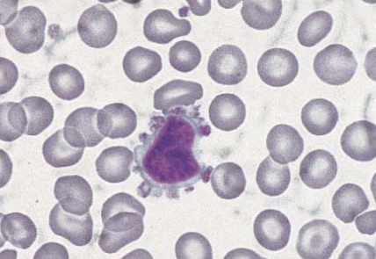
Platelet Satellitism
Peripheral blood smear showing platelet satellitism around a neoplastic lymphoid cell
Cesca, Christine "Platelet satellitism as presenting finding in mantle cell lymphoma: case report." Am j clin path 115.4 (2001): 567-570.
Copyright 2021 © Jeffrey Dach MD

Slide 84
TGFβ1 Platelets Major Storage Site
In 2017, Dr. Omar Elaskalani et al. write: “Platelets are the major storage site for TGFβ1 [transforming growth factor beta1] within the blood circulation, which is released from α-granules [platelet-derived granules] upon activation…. “
“Soluble platelet-derived factors [mainly TGFβ1] and direct physical contact with tumour cells activating NF-κB pathway work synergistically to induce EMT and subsequent migration and metastasis.” (2)
2) Elaskalani, Omar, et al. “Targeting Platelets for the Treatment of Cancer.” Cancers 9.7 (2017): 94
Copyright 2021 © Jeffrey Dach MD
Notes:
In 2017, Dr. Omar Elaskalani et al. write:
Platelets are the major storage site forTGFβ1 [transforming growth factor beta1] within the blood circulation, which isreleased from α-granules [platelet-derived granules] upon activation…. platelet-derived TGFβ1 … induce(s) a phenotypic
conversion in cancer cells, from epithelial to mesenchymal-like cells [EMT], capable of invading extracellular matrices, migrating
and surviving in the blood circulation … Soluble platelet-derived factors [mainly TGFβ1] and direct physical contact with
tumour cells activating NF-κB pathway work synergistically to induce EMT and subsequent migration and metastasis. (2)

Slide 85
Platelet Derived TGFβ1 Immune Modulator
Platelet-Derived TGF-Beta Is an Immune Modulator by Enhancing Differentiation of T cells toward T-reg cells. (35)
In 2018, Dr. Min Soon Cho et al. studied a murine model of ovarian cancer, finding platelet inhibition restores anti-tumor immune response and could be used as adjunct to checkpoint inhibitors and other immunotherapies. (36)
35) Rachidi, Saleh, et al. "Platelets subvert T cell immunity against cancer via GARP-TGFβ axis." Science immunology 2.11 (2017).
36) Cho, Min Soon, et al. “The Inhibition of Platelets Restore Anti-Tumor Immune Response to Ovarian Cancer and Its Therapeutic Implication.” Blood 132. Supplement 1 (2018): 3698-3698.
Copyright 2021 © Jeffrey Dach MD
Notes:
Platelet-Derived TGF-Beta Is an Immune Modulator
In 2018, Dr. Min Soon Cho et al. studied a
murine model of ovarian cancer, finding that platelet inhibition restores anti-tumor immune
response and could be used as adjunct to checkpoint inhibitors and other immunotherapies.
(36)
Activated platelets release TGFβ to the tumor microenvironment (TME) that enhances cancer cell proliferation in a TGFβ dose-dependent manner. Platelet TGFβ also functions as an immune modulator by enhancing differentiation of T cells toward T-reg. Platelets not only increase cancer cell proliferation but also alter the immune response to cancer by suppressing the function of tumor-infiltrating T cells. The presence of tumor-infiltrating lymphocytes (TIL) is associated with a significant improvement in the progression-free survival (PFS) and the overall survival (OS) of patients with ovarian cancer.

Slide 86
TGF-β - Pregnancy and Cancer
“We Can Understand Implantation in Early Pregnancy by Studying Tumor Progression” (Latifi 2019)
Latifi, Zeinab, et al. "Dual role of TGF-β in early pregnancy: clues from tumor progression." Biology of Reproduction 100.6 (2019): 1417-1430.
Copyright 2021 © Jeffrey Dach MD
Notes:
Latifi, Zeinab, et al. "Dual role of TGF-β in early pregnancy: clues from tumor progression." Biology of Reproduction 100.6 (2019): 1417-1430.
TGF-β signaling in the endometrium is active during the implantation period and has a pivotal role in regulating endometrial receptivity and embryo implantation. During embryo implantation, both apoptosis and proliferation of endometrial cells happen at the same time and it seems TGF-β is the factor that controls both of these processes. As shown in cancer cells, in special conditions this cytokine can have a dual effect and switch the action from apoptosis to proliferation. Owing to the similarity between embryo implantation and cancer development and also unusual pattern of proliferation and remodeling in the uterus, in this review we suggest the existence of such a switching in endometrium during the early pregnancy. Moreover, we address some potential mechanisms that could regulate the switching. A better understanding of the molecular mechanisms regulating TGF-β action and signaling during the implantation period could pave the way for introducing novel therapeutic strategies in order to solve implantation-associated issues such as repeated implantation failure.

Slide 87
TGFβ - Pregnancy and Cancer
2019 Dr. Latifi : “During embryo implantation, both apoptosis and proliferation of endometrial cells happen at the same time and it seems TGF-β is the factor that controls both of these processes.”
As shown in cancer cells…this cytokine (TGF-β) can have a dual effect and switch the action from apoptosis to proliferation.
“Owing to the similarity between embryo implantation and cancer development”… we suggest the existence of such a switching in endometrium during the early pregnancy.
Latifi, Zeinab, et al. "Dual role of TGF-β in early pregnancy: clues from tumor progression." Biology of Reproduction 100.6 (2019): 1417-1430.
Copyright 2021 © Jeffrey Dach MD
Notes:
Latifi, Zeinab, et al. "Dual role of TGF-β in early pregnancy: clues from tumor progression." Biology of Reproduction 100.6 (2019): 1417-1430.
TGF-β signaling in the endometrium is active during the implantation period and has a pivotal role in regulating endometrial receptivity and embryo implantation. During embryo implantation, both apoptosis and proliferation of endometrial cells happen at the same time and it seems TGF-β is the factor that controls both of these processes. As shown in cancer cells, in special conditions this cytokine can have a dual effect and switch the action from apoptosis to proliferation. Owing to the similarity between embryo implantation and cancer development and also unusual pattern of proliferation and remodeling in the uterus, in this review we suggest the existence of such a switching in endometrium during the early pregnancy. Moreover, we address some potential mechanisms that could regulate the switching. A better understanding of the molecular mechanisms regulating TGF-β action and signaling during the implantation period could pave the way for introducing novel therapeutic strategies in order to solve implantation-associated issues such as repeated implantation failure.

Slide 88
Platelet Inhibition -Dipyridamole
1960’s Boehringer Ingelheim DP as an antithrombotic agent, coronary vasodilator.
Phosphodiesterase inhibitor.
Prevents Platelet Activation.
Prevents Release of Platelet Growth Factors such as TGF-β, PDGF etc.
ASA/ Dipyridamole.
Born, Gustav, and Carlo Patrono. "Antiplatelet drugs." Briti j pharm 147. (2006): S241.
Sierko, E”Inhibition of platelet function: better cancer control?." Sem Thromb hemo 2007.
Copyright 2021 © Jeffrey Dach MD

Slide 89
Dipyridamole for Melanoma
1985 Dr. Rhodes in Lancet.
30 Melanoma Pts Rx DP, 300 mg a day. 11 Year F/U.
26 pts presented with Distant Metastatic Disease.
On DP: 77% 5 year survival.
Off DP 20-30% 5 year survival.
14) Rhodes, E. L., et al. “Dipyridamole for treatment of
melanoma.” The Lancet 325.8430 (1985): 693.
Copyright 2021 © Jeffrey Dach MD
Notes:
(1985) in Lancet by Dr. E. L. Rhodes et al., who treated thirty melanoma
patients over 11 years with DP, 300 mg a day. Of the thirty patients, 26 had distant metastatic
disease at the beginning of treatment. This group enjoyed a 77%, 5-year survival on dipyridamole
compared to the more dismal 20–30% survival for others not taking the drug. (14)

Slide 90
Dipyridamole for Breast Cancer Mouse Xenografts
2013 Dr. Daniela Spano, Mouse Xenograft Model for Breast Cancer.
DP Prevents Progression of TNBC
15) Spano, Daniela, et al. “Dipyridamole prevents TNBC progression.” Clin exper metastasis 30.1 (2013): 47-68..
Copyright 2021 © Jeffrey Dach MD

Slide 91
Dipyridamole for Breast Cancer
“Low dose DP significantly reduced primary tumor growth and metastasis…while high dose resulted in almost total reduction in primary tumor”…
“Dipyridamole had significant effects on Wnt (CSCs), MAPK/ERK (Kinases, Growth Signals) and NF-kB (Inflam) pathways in both animal models”...
“DP significantly decreased infiltration of TAMs and MDSC in primary tumors, and the inflammatory cytokines.” (Spano, 2013)
15) Spano, Daniela, et al. “Dipyridamole prevents TNBC progression.” Clin exper metastasis 30.1 (2013): 47-68..
Copyright 2021 © Jeffrey Dach MD
Notes:
MAPK (mitogen-activated protein kinases, originally called ERK, extracellular signal-regulated kinases)
TAMS tumor-associated macrophages and
MDSC myeloid-derived suppressor cells
In many cancers (e.g. melanoma), a defect in the MAP/ERK pathway leads to that uncontrolled growth. Many compounds can inhibit steps in the MAP/ERK pathway, and therefore are potential drugs for treating cancer,
What is The MAPK-ERK Signaling Pathway?
MAPK/ERK pathway (also known as the Ras-Raf-MEK-ERK pathway) is a chain of proteins in the cell that communicates a signal from a receptor on the surface of the cell to the DNA in the nucleus of the cell.
MAPKs signaling pathway is a highly conserved signaling pathway, which exists in lower prokaryotic cells and higher mammalian cells. The signaling pathway can transduce extracellular stimulation signals into cells and their nucleus, and ultimately cause a series of biological reactions such as cell proliferation, differentiation, transformation and apoptosis.
MAPK-ERK signaling pathways also called Raf/MEK/ERK pathway, which is the main signal pathway of MAPK signal pathway. The major functions of this signaling pathway involve the regulation of cell proliferation, transformation, differentiation and apoptosis. This signaling pathway is activated by a variety of hormones, growth and differentiation factors, tumour-promoting substances.

Slide 92
Dipyridamole MOA
Prevents platelet activation, which prevents release of Growth Factors VEGF, PDGF and TGF-β, COX2 into TME.
Restores Anti-Tumor Immune Response. (Adjunct to Checkpt Inhibs).
Inhibits cellular uptake of adenosine.
Inhibits the phosphodiesterase enzymes (PDE) that normally break down cAMP, thus increasing cellular cAMP levels in cells.
2) Elaskalani, Omar, et al. “Targeting Platelets for the
Treatment of Cancer.” Cancers 9.7 (2017): 94
Copyright 2021 © Jeffrey Dach MD
Notes:
Dipyridamole Mechanism of Action
Dipyridamole (DP) inhibits cellular uptake
of adenosine and inhibits the phosphodiesterase
enzymes (PDE) that normally break down cAMP, thus increasing cellular cAMP levels,
which prevents platelet activation. Other effects
include inhibition of smooth muscle proliferation
and lowering of pressure in pulmonary
hypertension.
Upon platelet activation, granules containing
growth factors such as VEGF, PDRF
and TGF (transforming growth factor beta 1)
are released into the tumor micro-environment,
feeding and stimulating cancer cells.
Dipyridamole blocks platelet activation by
increasing cAMP (cyclic AMP) inside platelets,
thus blocking release of growth factors. (2)(34)

Slide 93
Dipyridamole Synergy w Statins
2014 Dr Pandrya Screened 100 drugs (antimicrobials and metabolic regulators) for synergy with Atorvastatin in MM and AML cells.
“The combination of statins and dipyridamole is synergistically antiproliferative and induces apoptosis in AML and MM cell lines and primary patient cells.” (Pandrya 2014)
DP Inhibits Feedback loop, prevents compensatory upregulation of Mevalonate pathway after statin.
Pandyra, Aleksandra, et al. "Immediate utility of two approved agents to target both the metabolic mevalonate pathway and its restorative feedback loop." Cancer research 74.17 (2014): 4772-4782.
Copyright 2021 © Jeffrey Dach MD

Slide 94
Dipyridamole References
Elaskalani, Omar, et al. “Targeting Platelets for Treatment of Cancer.” Cancers 9.7 (2017): 94
Gamboa, Alfredo, et al. “Role of adenosine and nitric oxide on the mechanisms of action of dipyridamole.” Stroke 36.10 (2005): 2170
Takehara, K “Dipyridamole specifically decreases platelet-derived growth factor release from platelets.” Pharm 40.3 (1990): 150-156
Tzanakakis, “Prevention of human pancreatic cancer cell‐induced hepatic metastasis in nude mice by dipyridamole and its analog RA‐233.” Cancer 71.8 (1993): 2466-2471.
36) Cho, Min Soon, et al. “The Inhibition of Platelets Restore Anti-Tumor Immune Response to Ovarian Cancer and Its Therapeutic Implication.” Blood 132. Supplement 1 (2018): 3698-3698
Rachidi, Saleh, et al. “Platelets subvert T cell immunity against cancer via GARP-TGFβ axis.” Science immunology 2.11 (2017).
Copyright 2021 © Jeffrey Dach MD

Slide 95
Cancer as a Trophoblastic Disease Summary Slide
Similarity in molecular circuitry, immune evasion, inflammation - Trophoblasts - Cancer.
PIBF, Mifepristone AntiCancer Effects
William Coley – The Father of Immunotherapy.
SR/CR Mouse/The Mouse that Killed Cancer.
Cimetidine Immune Stimulator.
Beta Glucans Immune Stimulator.
Celecoxib, COX-2 Inhibitors .
Dipyridamole Prevents Platelet Activation, Prevents Release of TGF-β, PDGF.
Copyright 2021 © Jeffrey Dach MD
Notes:
Dipyridamole Mechanism of Action
Dipyridamole (DP) inhibits cellular uptake
of adenosine and inhibits the phosphodiesterase
enzymes (PDE) that normally break down cAMP, thus increasing cellular cAMP levels,
which prevents platelet activation. Other effects
include inhibition of smooth muscle proliferation
and lowering of pressure in pulmonary
hypertension.
Upon platelet activation, granules containing
growth factors such as VEGF, PDRF
and TGF (transforming growth factor beta 1)
are released into the tumor micro-environment,
feeding and stimulating cancer cells.
Dipyridamole blocks platelet activation by
increasing cAMP (cyclic AMP) inside platelets,
thus blocking release of growth factors. (2)(34)

Slide 96
Thank You – Any Questions?
TrueMedMD 7450 Griffin Road Suite 180/190 Davie, Fl 33314
954-792-4663 www.jeffreydachmd.com
Slides Available at: http://jeffreydachmd.com

Slide 97
Free Newsletter
www.jeffreydachmd.com
For assistance with any questions, Contact Me at the above contact page.
Copyright 2021 © Jeffrey Dach MD

Slide 98
Extra Slides After This Point

Slide 99
Both T and C Secrete PIBF
Cancer as a Trophoblastic Disease:
This is the theory that cancer is a form of “placental cell” or “germ cell” which uses many of the same molecular circuits as trophoblast cells use, to invade locally, induce its own blood supply, and evade the immune system of the host. The trophoblast is the Placental Cell of Pregnancy. Both cancer cells and trophoblast cells secrete HCG (human chorionic gonadotropin) and PIBF (progesterone induced blocking factor). (41)
Piechowski, Jean. “Plausibility of trophoblastic-like regulation of cancer tissue.” Cancer Management and Research 11 (2019): 5033.
Copyright 2021 © Jeffrey Dach MD
Notes:
Cancer as a Trophoblastic Disease
This is the theory that cancer is a form of “placental
cell” or “germ cell” which uses many of the
same molecular circuits as trophoblast cells use,
to invade locally, induce its own blood supply,
and evade the immune system of the host. The
trophoblast is the Placental Cell of Pregnancy.
Both cancer cells and trophoblast cells secrete
HCG (human chorionic gonadotropin) and PIBF
(progesterone induced blocking factor). (41)

