Slide 1
Best Answer For Cancer
Artemisinin and
Non-Toxic Targeted Cancer Therapies
Jeffrey Dach MD
7450 Griffin Road Suite 190
Davie, FL 33021
954-792-4663
www.jeffreydachmd.com
Slides Available At: http://www.jeffreydachmd.com

Slide 2
Most of the Drugs
Mentioned
In This Talk
Are OFF-Label Use
Slides Available At:: http://www.jeffreydachmd.com

Slide 3

The Myth - NO Cure for Cancer
Medicine Man 1992
Elusive Rare Flower in Amazon Rainforest cures
Cancer ?
3000 plant species have anticancer activity (Gali 2015)
Notes:
Gali-Muhtasib, Hala, et al. "Cell death mechanisms of plant-derived anticancer drugs: beyond apoptosis." Apoptosis 20.12 (2015): 1531-1562.3000 plant species anticancer

Slide 4

Anti- Malaria Drugs Serve
As Anti-Cancer Drugs
Kundu, Chanakya Nath, et al. “Anti-malarials are anti-cancers and vice versa–One arrow two sparrows.” Acta tropica 149 (2015):
Notes:
Kundu, Chanakya Nath, et al. “Anti-malarials are anti-cancers and vice versa–One arrow two sparrows.” Acta tropica 149 (2015): 113-127

Slide 5
Anti-Malarials are Anti-Cancer
Taxol and its derivatives
Quinine and its derivatives
Artemisinin and its derivatives
Curcumin and its derivatives
Resveratrol- Pterostilbene
Vinblastine
Piperine
Camptothecin
Betulinic acid
Quassinoid.
Notes:
Kundu, Chanakya Nath, et al. “Anti-malarials are anti-cancers and vice versa–One arrow two sparrows.” Acta tropica 149 (2015): 113-127

Slide 6
More
Doxorubicin
Dolastatins
Lentinan
Methotrexate and its derivatives
Daunorubicin
Primaquine
Doxycycline
Notes:
Kundu, Chanakya Nath, et al. “Anti-malarials are anti-cancers and vice versa–One arrow two sparrows.” Acta tropica 149 (2015): 113-127

Slide 7

2015 Nobel Prize in Medicne
Tu You You
Discovered Artemisinin anti-malarial taken by
2 million people.

Slide 8
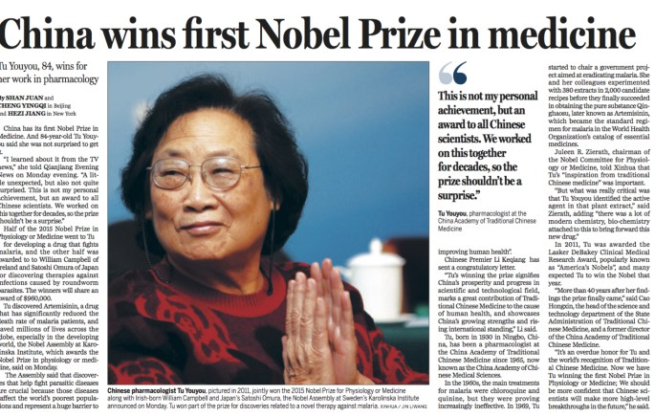

Slide 9
Artemisinin
Artemisinin (or derivatives) are effective against 55 cancer cell lines
Pancreatic cancer, osteosarcoma, lung cancer, colon, melanoma, breast, ovarian, prostate, central nervous system, lymphoma, leukemia and renal cancer cells. (1)
Das A K. Anticancer effect of antimalarial artemisinin compounds. Ann Med Health Sci Res [serial online] 2015 [cited 2016 Feb 13];5:93-102.
Notes:
Das A K. Anticancer effect of antimalarial artemisinin compounds. Ann Med Health Sci Res [serial online] 2015 [cited 2016 Feb 13];5:93-102.

Slide 10
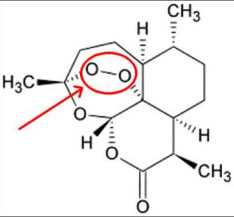
Artemisinin Molecular Structure
Endoperoxide Bridge
Oxygen Reacts with Fe
Fenton Reaction
Oxidation
Notes:
Skeletal formula of artemisinin. Created using ACD/ChemSketch 10.0 and Inkscape.
Date 12 April 2007
Source Own work
Author Fvasconcellos 23:05, 12 April 2007 (UTC)

Slide 11
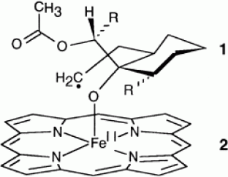
Artemisinin Reacting With Iron
Endoperoxide Bridge
Oxygen Reacts with Fe
Robert Anne et al. 2001
Notes:
Robert, Anne, Jérôme Cazelles, and Bernard Meunier. “Characterization of the alkylation product of heme by the antimalarial drug artemisinin.” Angewandte Chemie International Edition 40.10 (2001): 1954-1957.

Slide 12
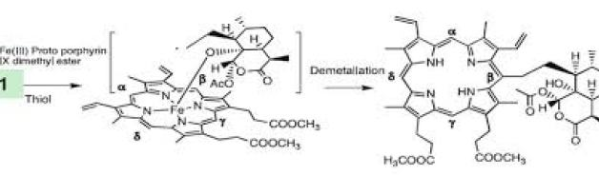

Artemisinin Reacting With Fe
Oxygen reacts with Fe – Protoporphyrin Ester
Fe Removed
Demetalization
Notes:
Artemisinin reacting with Heme courtesy of O’neill, et al Molecular Mechanism of Action of Artemisinine Debate ONeill 2010. (131)

Slide 13
High Iron Content of Neoplastic Cells
“Neoplastic cells express high levels of the transferrin receptor 1 (TfR1) and internalize iron (Fe) from transferrin (Tf) at a tremendous rate.”
Kwok, Juliana C.,et al “The iron metabolism of neoplastic cells.” Critical Reviews in Oncology/Hematology 42.1 (2002): 65-78.
Notes:
Kwok, Juliana C., and Des R. Richardson. “The iron metabolism of neoplastic cells: alterations that facilitate proliferation?.” Critical Reviews in Oncology/Hematology 42.1 (2002): 65-78.

Slide 14
Cancer Cells Have Increased Iron and Transferrin Receptors
To Enhance Effect of Artemisin,
Give Iron IV or PO.
Enhancement of cytotoxicity of artemisinins toward cancer cells by ferrous iron..Efferth et al Free Radic Biol Med. 2004 .
Notes:
Free Radic Biol Med. 2004 Oct 1;37(7):998-1009. Enhancement of cytotoxicity of artemisinins toward cancer cells by ferrous iron. Efferth T1, Benakis A, Romero MR, Tomicic M, Rauh R, Steinbach D, Häfer R, Stamminger T, Oesch F, Kaina B, Marschall M.

Slide 15
Cancer Cells Contain Massive Amounts of Iron in Lysosomes
Cancer cells express high levels of the transferrin receptors for internalizing iron (Fe) at a tremendous rate. Kwok, Juliana et al. 2002.
Rapidly growing tumor cells, but not their normal counterparts, highly express Tf receptors (TfR) and require transferrin for cell growth and survival. TfR is highly expressed on Mantle Cell Lymphoma cells.Lepelletier et al 2007
Notes:
Kwok, Juliana C., and Des R. Richardson. “The iron metabolism of neoplastic cells: alterations that facilitate proliferation?.” Critical Reviews in Oncology/Hematology 42.1 (2002): 65-78.
Lepelletier Y1, Camara-Clayette V, Jin H, Hermant A, Coulon S, Dussiot M, Arcos-Fajardo M, Baude C, Canionni D, Delarue R, Brousse N, Benaroch P, Benhamou M, Ribrag V, Monteiro RC, Moura IC, Hermine OCancer Res. 2007 Feb 1;67(3):1145-54.
Prevention of mantle lymphoma tumor establishment by routing transferrin receptor toward lysosomal compartments..

Slide 16
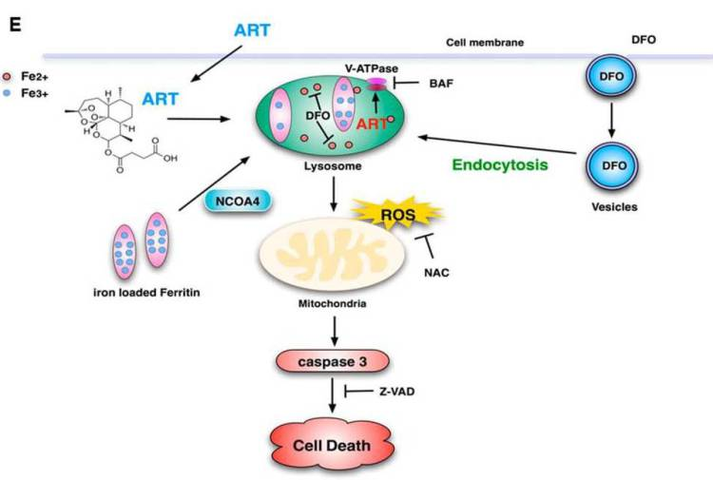
Mode of Action Cancer Cell Death
Artemisinin
DFO
NAC
Notes:
Figure 9E from Yang et al. Artemisinin enters cancer cell along with iron loaded ferritin. Both enter the lysosome which then triggers mitochondria reactive oxygen species (ROS) and caspase 3 programmed cell death.(6)
Yang, Nai-Di, et al. “Artesunate induces cell death in human cancer cells via enhancing lysosomal function and lysosomal degradation of ferritin.” Journal of Biological Chemistry 289.48 (2014): 33425-33441. (full free)

Slide 17
Artemisinin Reacting With Iron
Yang, Nai-Di, et al. “Artesunate induces cell death in human cancer cells via enhancing lysosomal function and lysosomal degradation of ferritin.” Journal of Biological Chemistry 289.48 (2014): 33425-33441. (full free)

Slide 18
Lysosomal Inhibitors and Iron Chelators Block Effect of Artemisinin
Chloroquin inhibits Ferritin Degradation and Cell Death induced by ART
BAF is a lysosomal inhibitor which prevents artemisinin cell death.
DFO is iron chelator which inhibits cell death.
NAC (N acetyl cysteine inhibits ROS )inhibits cell death.
From: Yang, Nai-Di, et al. (6) “Artesunate induces cell death in human cancer cells “

Slide 19
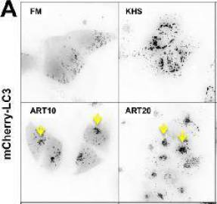
Lysosomal Clustering at Nucleus
Top Row are Untreated Breast Cancer Cells showing lysosomes (dark stained particles) dispersed throughout cells.
Bottom Row, Breast cancer cells treated with Artemisinin. (Yellow arrows) peri-nuclear clustering of autophagosomes (lysosomes).
Notes:
Images from Figure 3 courtesy of Hamacher-Brady, Anne, et al.(80) “Artesunate Activates Mitochondrial Apoptosis in Breast Cancer Cells via Iron-catalyzed Lysosomal Reactive Oxygen Species Production.” J. Biol. Chem 2011.286 (2010): 6587-6601.

Slide 20
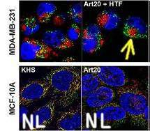
Lysosomal Clustering at Nucleus
Breast Cancer Cells (Top row, yellow arrow) treated with artemisinin and holotransferrin
Clustering of mitochondria (green) and lysosomes(red). Normal breast cells (lower row) show no clustering effects.).
Notes:
Images from Figure 9 courtesy of Hamacher-Brady, Anne, et al.(80) “Artesunate Activates Mitochondrial Apoptosis in Breast Cancer Cells via Iron-catalyzed Lysosomal Reactive Oxygen Species Production.” J. Biol. Chem 2011.286 (2010): 6587-6601.

Slide 21
Artemisinin Randomized Trial
Dr. Sanjeev Krishna at St George University London in 2010.(71)
This randomized study was done with 20 colon cancer patients awaiting surgery.
half received the Artesunate pill for two weeks prior to surgery, and the other half a placebo.
Five years later, there were 6 cancer recurrences in the placebo group, but only one in the Artesunate (Artemisinin) group.
There were no deaths in the Artesenate group, compared to three deaths in the placebo group.
Krishna, Sanjeev, et al. “A randomised, double blind, placebo-controlled pilot study of oral artesunate therapy for colorectal cancer.” EBioMedicine 2.1 (2015): 82-90.
Notes:
(71) Krishna, Sanjeev, et al. “A randomised, double blind, placebo-controlled pilot study of oral artesunate therapy for colorectal cancer.” EBioMedicine 2.1 (2015): 82-90.

Slide 22
How to Increase Effect of Artemisinin?
Deliver Iron to the Cancer Cell
Down Regulate Intracelluar Glutathione
Removes Anti-Oxidant Protection
Other Non-Toxic Therapies in Combination Having a Synergistic Anti-Tumor Effect.

Slide 23
Downregulate Glutathione with Sulfasalazine
Long History of Use in Inflammatory bowel disease and rheumatoid arthritis.
Suppression of Nuclear Factor Kappa Beta.
Blocks Xct Cystine Active Transport
Starves Lymphoma Cell of Cystine
Down-Regulates Intracellualar Glutathione
Strips Cancer Cell of Anti-Oxidant Defenses upregulated in chemoresistant cell lines, and upregulated in Cancer Stem Cells.
Notes:
Gout, P. W., et al. “Sulfasalazine, a potent suppressor of lymphoma growth by inhibition of the x c-cystine transporter: a new action for an old drug.” Leukemia (08876924) 15.10 (2001).
Bebb, G., et al. "Sulfasalazine, inhibits growth of mantle cell lymphoma (MCL) cell cultures via cyst (e) ine starvation and delays tumour growth in a newly developed murine MCL model." BLOOD. Vol. 102. No. 11. 1900 M STREET. NW SUITE 200, WASHINGTON, DC 20036 USA: AMER SOC HEMATOLOGY, 2003.
Wahl, Christian, et al. "Sulfasalazine: a potent and specific inhibitor of nuclear factor kappa B." Journal of Clinical Investigation 101.5 (1998): 1163.

Slide 24
Sulfasalazine Blocks Upregulated
Cystine Transport in Cancer Stem Cells
Sulfasalazine
Toyokuni, Shinya. “Iron and thiols as two major players in carcinogenesis: friends or foes?.” The Changing Faces of Glutathione, a Cellular Protagonist (2015): 114. Fig 9.
Notes:
Toyokuni, Shinya. “Iron and thiols as two major players in carcinogenesis: friends or foes?.” The Changing Faces of Glutathione, a Cellular Protagonist (2015): 114. Toyokuni Shinya Iron thiols carcinogenesis Cellular Protagonist 2015 Hideyuki Saya's group reported that cancer stem cells in certain cancers present CD44 variant 8-10 (CD44v) isoform on the plasma membrane, which stabilizes the cystine/glutamate transporter (antiporter; xCT), leading to increased GSH (Ishimoto et al., 2011). This may at least partially explain the robustness of cancer cell defenses against oxidative stress, including those involved in chemotherapy-resistance. There is already an xCT antagonist, sulfasalazine, and clinical trials are underway in advanced gastric cancer in Japan (Figure 9A). Figure 9. Key role of the cystine/glutamate antiporter in cancer cells. (A) Overexpression of CD44v(8-11) stabilizes the cystine/glutamate antiporter to increase cysteine and glutathione (GSH) in cancer stem cells. (B) Conversely, erastin blocks the cystine/glutamate antiporter, lowers cysteine and finally induces iron-dependent cancer cell death (ferroptosis), which can be blocked with deferoxamine (DFO).

Slide 25
Effect of Sulfasalazine on Cancer Stem Cells
Gastric Cancer Patients -Biopsies evaluated before and after sulfasalazine for CD44
Optimal dose of SSZ was 8g/day x 2 weeks
Down regulation of CD44v expression and decreased level of GSH shows drug-on-target effect and mode of action of SSZ for CSCs.
Shitara, Kohei, et al. "Effect of sulfasalazine (SSZ) on cancer stem-like cells (CSCs) via inhibiting xCT signal pathway: Phase 1 study in patients with gastric cancer (EPOC 1205)." ASCO Annual Meeting Proceedings. Vol. 32. No. 15_suppl. 2014.. Stem
Notes:
Shitara, Kohei, et al. "Effect of sulfasalazine (SSZ) on cancer stem-like cells (CSCs) via inhibiting
xCT signal pathway: Phase 1 study in patients with gastric cancer (EPOC 1205)." ASCO Annual Meeting
Proceedings. Vol. 32. No. 15_suppl. 2014.

Slide 26
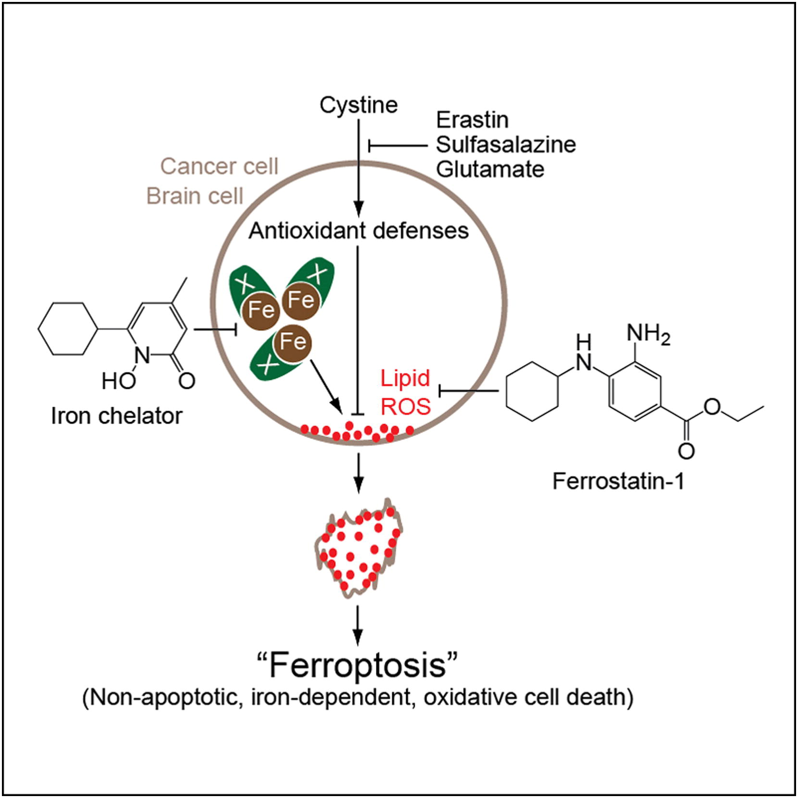
Sulfasalazine
Induces Ferroptosis-
Fibro
Sarcoma
Cell Line
Ferroptosis is triggered by inhibition of cystine uptake
Reduced cystine uptake leads to the production of lethal lipid ROS
Notes:
Ferroptosis is triggered by inhibition of cystine uptake
Reduced cystine uptake leads to the production of lethal lipid ROS
Dixon et al., “Ferroptosis: An Iron-Dependent Form of Nonapoptotic Cell Death ”. Cell, vol 149, pp. 1060‒1072 (2012).

Slide 27
Sulfasalazine inhibits Lymphoma
Dr Gout found that sulfasalazine suppressed 90% of lymphoma xenografts in mice, a remarkable finding. Gout PW Leukemia 2001
Sulfasalazine inhibits growth of mantle cell lymphoma in a murine MCL model as reported by Dr Bebb in 2003 Blood.Vol 102, No11.
Notes:
Gout, P. W., et al. “Sulfasalazine, a potent suppressor of lymphoma growth by inhibition of the x c-cystine transporter: a new action for an old drug.” Leukemia (08876924) 15.10 (2001).
Bebb, G., et al. "Sulfasalazine, inhibits growth of mantle cell lymphoma (MCL) cell cultures via cyst (e) ine starvation and delays tumour growth in a newly developed murine MCL model." BLOOD. Vol. 102. No. 11. 1900 M STREET. NW SUITE 200, WASHINGTON, DC 20036 USA: AMER SOC HEMATOLOGY, 2003.

Slide 28
Artemisinin Synergies

Slide 29
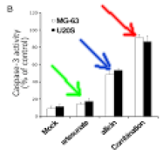
Artemisinin plus Allicin (Garlic)
Osteosarcoma Cell Line
Caspace 3 Activity
Apoptosis levels after treating Osteosarcoma cells (in culture)
Artesunate (green arrow),
Allicin (blue arrow) or
Combination of Artesunate and Allicin (Red Arrow)
Notes:
Jiang, Wei, et al. "The synergistic anticancer effect of artesunate combined with allicin in osteosarcoma cell line in vitro and in vivo." Asian Pacific Journal of Cancer Prevention 14.8 (2013): 4615-4619.
Left Image Fig 3B from Jiang showing synergistic effect of combining Artesunate (an Artemisin derivative) with Allicin. Bar Chart shows apoptosis levels after treating Osteosarcoma cells (in culture) with Artesunate (green arrow), Allicin (blue arrow) or combination of Artesunate and Allicin (Red Arrow). (57) Dr Jiang also reported additional mouse tumor xenograft studies were done, and these in-vivo studies also showed enhanced synergy for the combination of Allicin and Artesunate. (57)

Slide 30
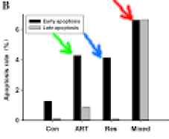
Artemisinin plus Resveratrol Hepatoma , Cervical Ca Cell lines.
Apoptosis Count
Artemisinin (green arrow),
Resveratrol (blue arrow) and the
Combination (red arrow) for two cancer cell lines (black and grey bars) Li et al 2014.
Notes:
J Cancer Res Clin Oncol. 2014 Dec;140(12):2065-75. Synergic effects of artemisinin and resveratrol in cancer cells.
Li P1, Yang S, Dou M, Chen Y, Zhang J, Zhao X.
In 2014, Drs Li and Yang reported a synergistic effect of the combination of Resveratrol with Artemisinin in Hepatoma (HepG2) and Cervical Cancer (HeLa) cell lines

Slide 31
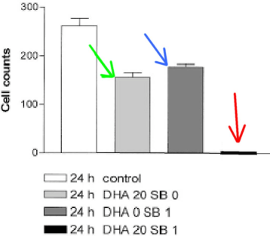
Dihydroartimisin and Butyrate lymphoblastic leukemia cell line
Cell Count after treatment with Dihydroartemisinin (Green Arrow),
Butyrate (blue Arrow),
Combination (Red Arrow) after
Notes:
Dr Lai reports in 2005 that the cancer cell killing effect of Artemisinin is enhanced with the addition of butyrate, a short chain fatty acid.(76) Their study used a lymphoblastic leukemia cell line, treated with a combination of dihydroartimisin and butyrate.

Slide 32
Targeting
Cancer Stem Cells with
Non-Toxic Therapies
Notes:
Li, Yanyan, et al. “Implications of cancer stem cell theory for cancer chemoprevention by natural dietary compounds.” The Journal of nutritional biochemistry 22.9 (2011): 799-806.

Slide 33
(Progenitor) Cancer Stem Cells (CSCs)
CSCs responsible for tumor relapse
Resistant to cytotoxic chemotherapy
Cell markers CD44
Secondary spheres
Differentiating
Self-renewal
Dr Yanyan Li 2011 (134)
Notes:
Li, Yanyan, et al. “Implications of cancer stem cell theory for cancer chemoprevention by natural dietary compounds.” The Journal of nutritional biochemistry 22.9 (2011): 799-806.

Slide 34
(Progenitor)
Cancer Stem Cells (CSCs)
Wnt/β-catenin signaling is implicated in CSCs of, melanoma, breast , colon, liver , lung cancers.
WNT OFF - Elimination of β-catenin.
B-Catenin - T cell factor/lymphoid enhancer factor (TCF/LEF) transcription activator
c-Jun, c-Myc, Cyclin D1
Notes:
Li, Yanyan, et al. “Implications of cancer stem cell theory for cancer chemoprevention by natural dietary compounds.” The Journal of nutritional biochemistry 22.9 (2011): 799-806.

Slide 35
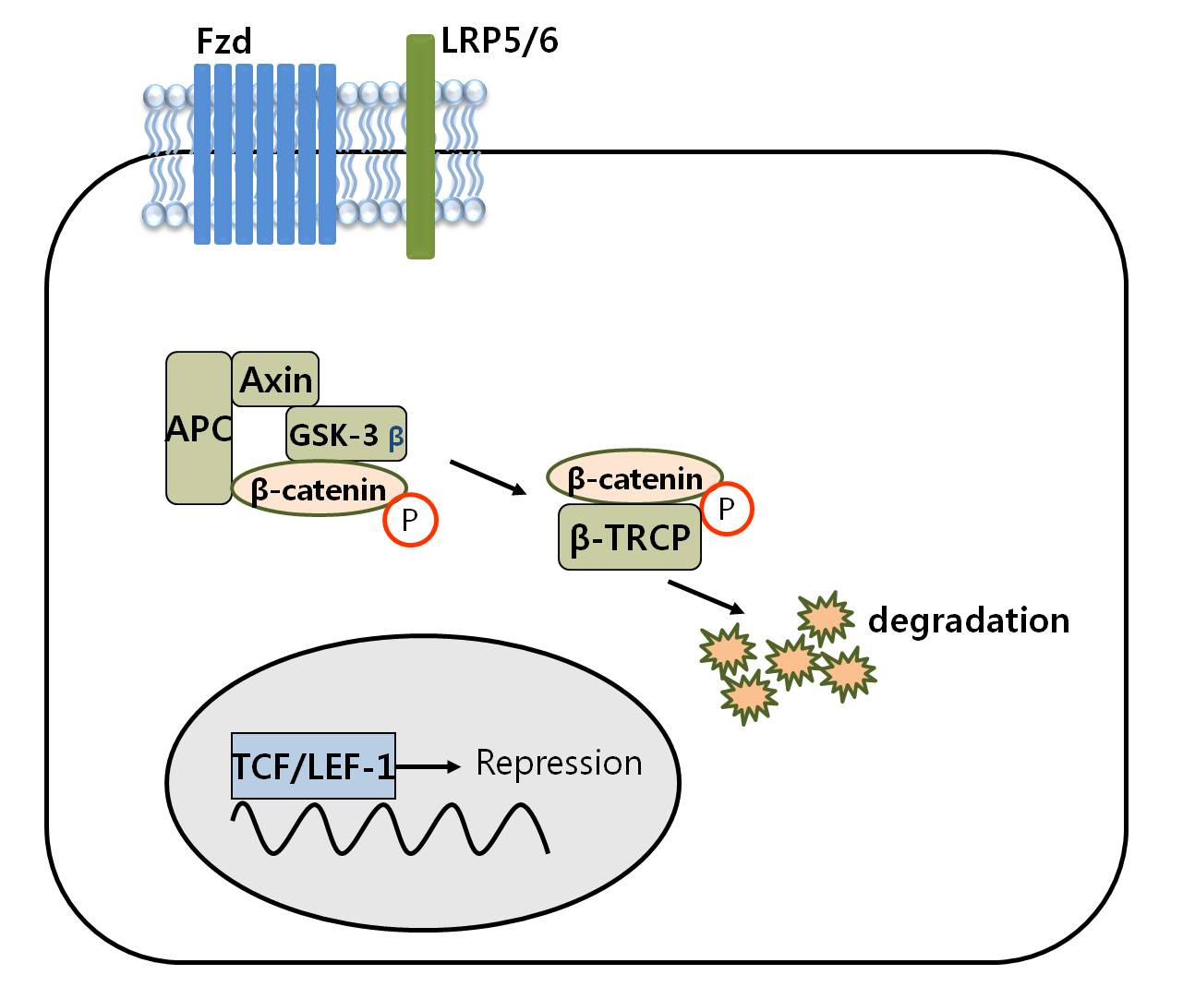
WNT OFF
Notes:
Figure 1. Regulation of Wnt/β-catenin signaling pathway. In the absence of Wnt signals, the cellular concentration of free β-catenin is low, because a complex of the adenomatous polyposis coli (APC), glycogen synthase kinase 3β (GSK-3β) and axin protein is responsible for regulating the level of β-catenin, via GSK-3β-mediated phosphorylation of specific serin and threonine residues in β-catenin.
From: Chapter 3 Wnt/β-Catenin Signaling Pathway in Canine Skin Melanoma and a Possibility as a Cancer Model for Human Skin Melanoma By Jae-Ik Han and Ki-Jeong Na

Slide 36
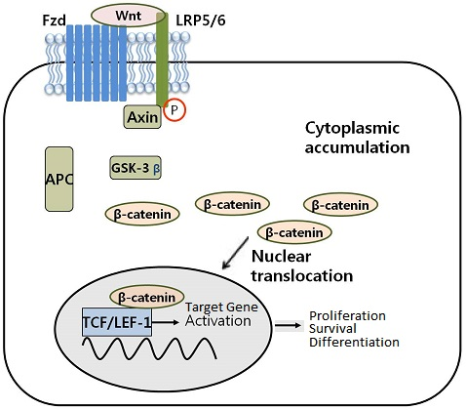
WNT ON
Cyclin D1
Notes:
Figure 2. Regulation of Wnt/β-catenin signaling pathway. Upon Wnt signaling, the activity of GSK-3β is inhibited by Dsh, hence β-catenin is accumulated in the cytoplasm. The accumulated β-catenin can enter the nucleus and activates the target genes such as LEF-1, c-myc and cyclin D1.
From: Chapter 3 Wnt/β-Catenin Signaling Pathway in Canine Skin Melanoma and a Possibility as a Cancer Model for Human Skin Melanoma By Jae-Ik Han and Ki-Jeong Na

Slide 37
WNT / Beta Catenin Signaling
Wnt/β-catenin signaling OFF - GOOD
Wnt/β-catenin ON - BAD
Wnt/β-catenin Upregulated in Cancer Stem cells
Inhibiting Wnt/β-catenin kills cancer stem cells
Notes:
Li, Yanyan, et al. “Implications of cancer stem cell theory for cancer chemoprevention by natural dietary compounds.” The Journal of nutritional biochemistry 22.9 (2011): 799-806.
Mathur, Rohit, et al. “Targeting Wnt pathway in mantle cell lymphoma-initiating cells.” Journal of hematology & oncology 8.1 (2015): 63.

Slide 38
WNT Up-regulated in
Cancer Stem Cells 100 Fold
Stem Cells have elevated expression of Wnt target genes encoding ID2 and TCF4 (both >100-fold) compared with MCL non-ICs.
MCL-ICs- Dormant (non-replicating) -Resistant to conventional chemotherapy (vincristine, doxorubicin ibrutinib)
Inhibition of Wnt signaling preferentially eliminates MCL-ICs
Mathur, Rohit, Jorge Romaguerra, Michael Wang et al. “Targeting Wnt pathway in mantle cell lymphoma-initiating cells.” Journal of hematology & oncology 8.1 (2015): 63. From MD Anderson Center.
Notes:
Mathur, Rohit, Jorge Romaguerra, Michael Wang et al. “Targeting Wnt pathway in mantle cell lymphoma-initiating cells.” Journal of hematology & oncology 8.1 (2015): 63. MD Anderson.

Slide 39
(Progenitor)
Cancer Stem Cells (CSCs)
Non-Toxic Targeted Therapies
Dietary compounds can directly or indirectly affect Cancer Stem Cell (CSCs) self-renewal pathways
Notes:
Li, Yanyan, et al. “Implications of cancer stem cell theory for cancer chemoprevention by natural dietary compounds.” The Journal of nutritional biochemistry 22.9 (2011): 799-806.
Mathur, Rohit, et al. “Targeting Wnt pathway in mantle cell lymphoma-initiating cells.” Journal of hematology & oncology 8.1 (2015): 63.

Slide 40
Targeting
(Progenitor) Cancer Stem Cells
Berberine
Resveratrol - Pterostilbene
Vitamin D3
Curcumin
Feverfew (Parthenolide)
Sulforaphane
Dr Yanyan Li 2011 (134)
Notes:
Li, Yanyan, et al. “Implications of cancer stem cell theory for cancer chemoprevention by natural dietary compounds.” The Journal of nutritional biochemistry 22.9 (2011): 799-806.

Slide 41
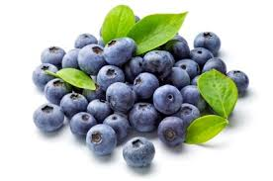
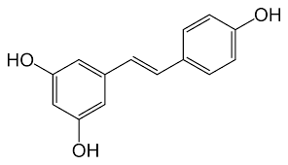
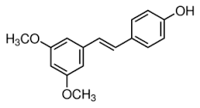
Pterostilbene-Resveratrol Derivative
resveratrol
pterostilbene
Methylated Version of Reservatrol
More Bio-Available

Slide 42
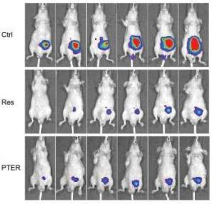
Pterostilbene – Prostate CA
Li, Kun, et al. "Pterostilbene acts through metastasis-associated protein 1 to inhibit tumor growth, progression and metastasis in prostate cancer." PloS one 8.3 (2013): e57542.
Notes:
Li, Kun, et al. "Pterostilbene acts through metastasis-associated protein 1 to inhibit tumor growth, progression and metastasis in prostate cancer." PloS one 8.3 (2013): e57542.

Slide 43
Pterostilbene – CA Stem Cells
Dr Chi-Hao Wu reported in 2015 that
Pterostilbene targets breast cancer stem cells.
Breast cancer cells (MCF-7) in vitro,
Pterotilbene selectively killed Breast Cancer Stem Cells which express the CD44 surface antigen.
Degradation of β-catenin, thus inhibiting expression of cancer growth factors C-Myc and Cyclin D1.
J Agric Food Chem. 2015 Mar 11;63(9):2432-41. Targeting cancer stem cells in breast cancer: potential anticancer properties of 6-shogaol and pterostilbene. Wu CH1, Hong BH, Ho CT, Yen GC.
Notes:
J Agric Food Chem. 2015 Mar 11;63(9):2432-41. Targeting cancer stem cells in breast cancer: potential anticancer properties of 6-shogaol and pterostilbene. Wu CH1, Hong BH, Ho CT, Yen GC.
Wu, Chi-Hao, et al. "Targeting cancer stem cells in breast cancer: potential anticancer properties of 6-shogaol and pterostilbene." Journal of agricultural and food chemistry 63.9 (2015): 2432-2441.

Slide 44
Feverfew-Parthenolide
Parthenolide preferentially targets AML progenitor and stem cell populations
inhibition of nuclear factor κ B (NF-κB), proapoptotic activation of p53,
and increased reactive oxygen species (ROS).
triggers Cancer Stem Cell-specific apoptosis
Guzman, Monica L., et al. “The sesquiterpene lactone parthenolide induces apoptosis of human acute myelogenous leukemia stem and progenitor cells.” Blood 105.11
Notes:
.Guzman, Monica L., et al. “The sesquiterpene lactone parthenolide induces apoptosis of human acute myelogenous leukemia stem and progenitor cells.” Blood 105.11 (2005): 4163-4169.

Slide 45
Feverfew-Parthenolide
Parthenolide is HDAC inhibitor (Histone De-Acetylase)
Gopal 2007
HDAC inhibitors (HDACi) activate both the death-receptor and intrinsic apoptotic pathways.
Notes:
Gopal, Y. N., T. S. Arora, and M. W. Van Dyke. "Parthenolide specifically depletes histone deacetylase 1 protein and induces cell death through ataxia telangiectasia mutated." Chemistry & biology 14.7 (2007): 813-823.

Slide 46
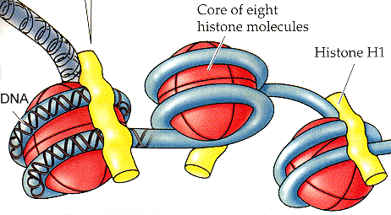
HDAC Inhibition
The DNA is wrapped around the histone core of eight protein subunits, forming the nucleosome. The nucleosome is clamped by histone H1. About 200 base pairs (bp) of DNA coil around one histone. The coil "untwists" so as to generate one negative superturn per nucleosome.
Methylation of histone or of DNA usually turns a gene off.
Acetylation of histone usually turns a gene on.
Notes:
Life, the Science of Biology, by Purves, Orians, & Heller, 5th ed., 1997
Methylation of histone or of DNA usually turns a gene off.
Acetylation of histone usually turns a gene on.

Slide 47
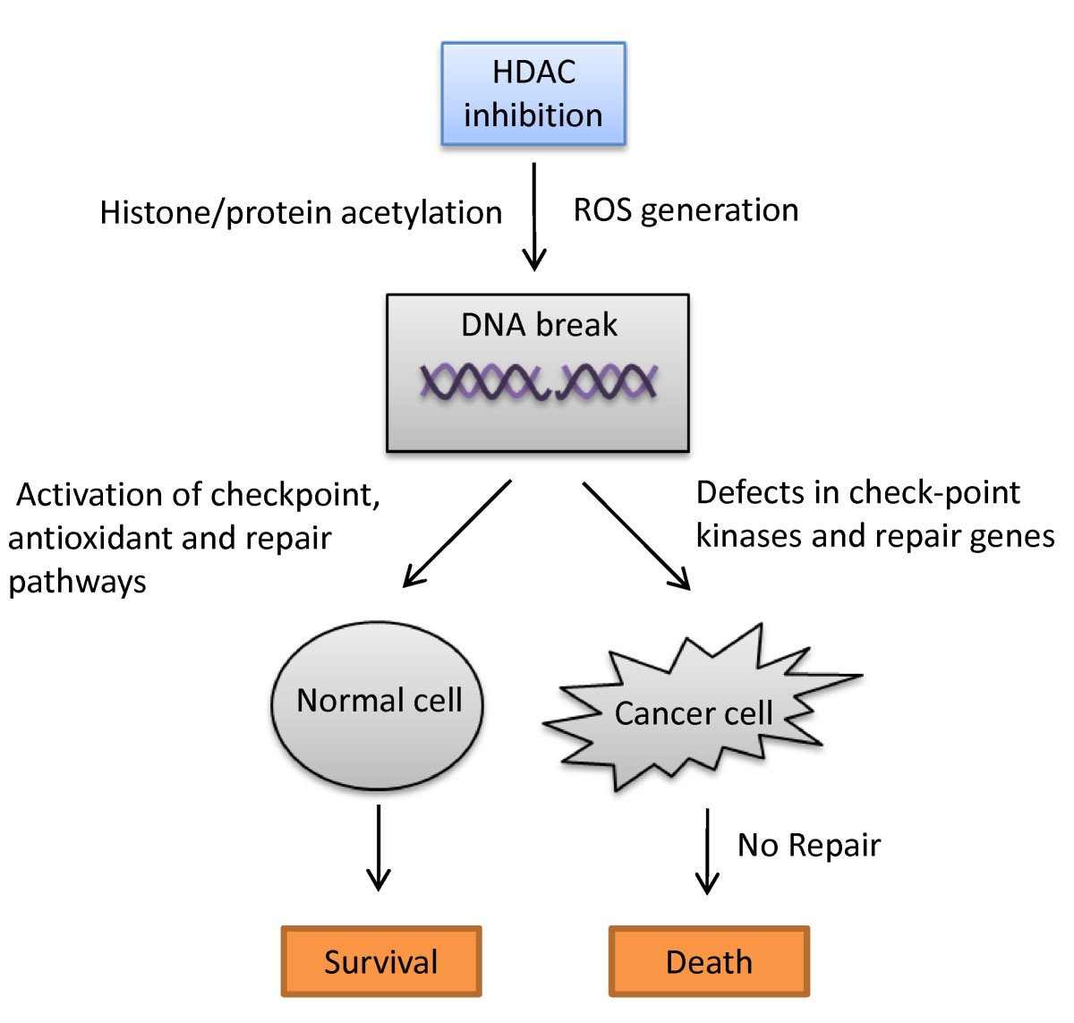
HDAC Inhibition
Rajendran, Praveen, et al. "Dietary phytochemicals, HDAC inhibition, and DNA damage/repair defects in cancer cells."Clinical epigenetics 3.1 (2011): 1.
Notes:
Rajendran, Praveen, et al. "Dietary phytochemicals, HDAC inhibition, and DNA damage/repair defects in cancer cells." Clinical epigenetics 3.1 (2011): 1.

Slide 48
Natural HDAC Inhibitors
Vorinostat and Romidepsin (depsipeptide), approved for Cutaneous T-cell Lymphoma
Sulforaphane
Parthenolide
Allium compounds Garlic, onions, shallots
Selenium
EGCG, polyphenolic catechin in green tea
Curcumin
Resveratrol/ pterostilbene
Quercetin
Butyrate-product of bacterila fermentation in colon
Notes:
The epigenetic effects of butyrate: potential therapeutic implications for clinical practice
Roberto Berni CananiEmail author, Margherita Di Costanzo and Ludovica Leone
Clinical EpigeneticsThe official journal of the Clinical Epigenetics Society 2012 4:4

Slide 49
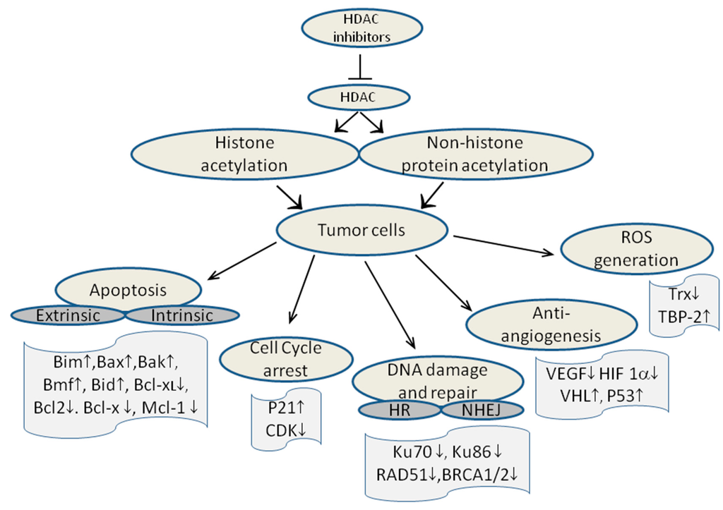
Natural HDAC Inhibitors
Mottamal, Madhusoodanan, et al. "Histone deacetylase inhibitors in clinical studies as templates for new anticancer agents." Molecules 20.3 (2015): 3898-3941.
Notes:
Mottamal, Madhusoodanan, et al. "Histone deacetylase inhibitors in clinical studies as templates for
new anticancer agents." Molecules 20.3 (2015): 3898-3941.

Slide 50
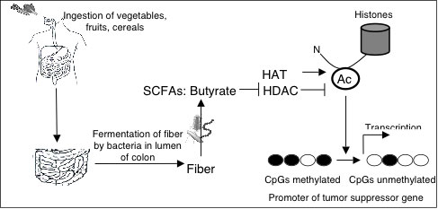
Butyrate
Notes:
Scott Bultman, PhD Dept of Genetics
5060 Genetic Medicine Bldg CB# 7264
120 Mason Farm Road Chapel Hill, NC 27599-7264

Slide 51
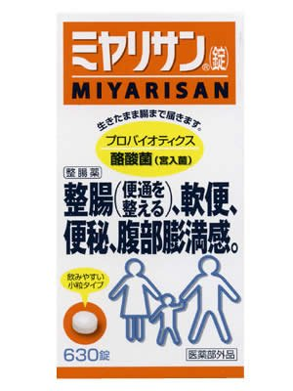
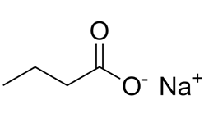
Butyrate made by
Probiotic from Japan
Butyrate induces apoptosis in Mantle Cell Lymphoma, Heider 2006
Notes:
Heider, Ulrike, et al. “Histone deacetylase inhibitors reduce VEGF production and induce growth suppression and apoptosis in human mantle cell lymphoma.” European journal of haematology 76.1 (2006): 42-50.

Slide 52
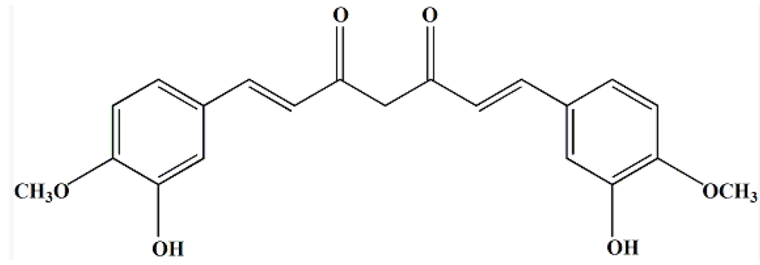
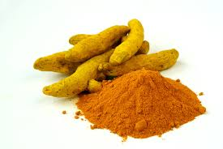
Curcumin
Notes:
22) Hasanali, Zainul, Kamal Sharma, and Elliot Epner. “Flipping the cyclin D1 switch in mantle cell lymphoma.” Best Practice & Research Clinical Haematology 25.2 (2012): 143-152.

Slide 53
Curcumin – GlioBlastoma Model
Bioluminescent imaging of Glioblastoma implanted into brainstem of mice treated with Curcumin (Lower panel)
Notes:
Figure 2. BLI analysis and quantification. Kim, Woong, et al. "Real‐Time Imaging Reveals Glioblastoma Suppression Effects of Curcumin in Mouse Brains." Bulletin of the Korean Chemical Society 36.5 (2015): 1528-1531.

Slide 54
Curcumin Down Regulates Cyclin D1
Dr. Elliot Epner from Penn State reports in 2012, “Curcumin…has been shown in vitro to downregulate cyclins D1 and D3 at both the transcriptional and post-transcriptional levels in Mantle Cell Lymphoma and Multiple Myeloma. ” (22)
Notes:
22) Hasanali, Zainul, Kamal Sharma, and Elliot Epner. “Flipping the cyclin D1 switch in mantle cell lymphoma.” Best Practice & Research Clinical Haematology 25.2 (2012): 143-152.

Slide 55
Curcumin
Potent inhibitory effect on Wnt/β-catenin signaling
Decreased β-catenin/TCF transcription activity
Inactivation of NF-κB DNA-binding activity mediated by Notch-1 signaling pathway
Li, Yanyan, et al. “The J Nut Bio 22.9 (2011): 799-806.
Notes:
Li, Yanyan, et al. “Implications of cancer stem cell theory for cancer chemoprevention by natural dietary compounds.” The Journal of nutritional biochemistry 22.9 (2011): 799-806.

Slide 56
Sulphoraphane Broccoli)
Targets cancer stem cells
Depletes glutathione in the cancer cell, thus rending it more sensitive to oxidative damage. Sestili 2015.
Potent inhibitor of Wnt/β-catenin signaling.
Li, Yanyan, et al. “The J Nut Bio 22.9 (2011): 799-806.
Notes:
Sestili, Piero, and Carmela Fimognari. “Cytotoxic and Antitumor Activity of Sulforaphane: The Role of Reactive Oxygen Species.” BioMed Research International 2015 (2015).
Li, Yanyan, et al. “Implications of cancer stem cell theory for cancer chemoprevention by natural dietary compounds.” The Journal of nutritional biochemistry 22.9 (2011): 799-806.

Slide 57
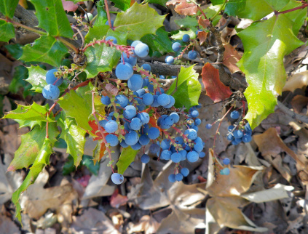
Berberine – Oregon Grape

Slide 58
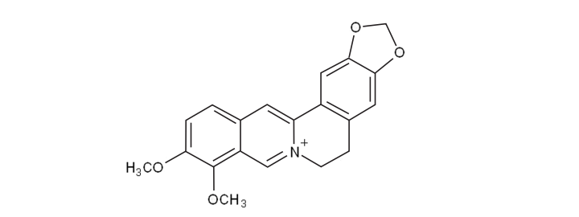
Berberine Chemical Structure

Slide 59
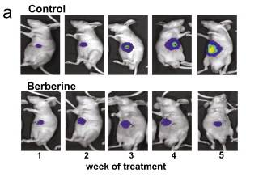
Berberine – Bioluminescence
HCC Xenograft
Notes:
Tsang, Chi Man, et al. "Berberine suppresses Id-1 expression and inhibits the growth and development of lung metastases in hepatocellular carcinoma." Biochimica et Biophysica Acta (BBA)-Molecular Basis of Disease 1852.3 (2015): 541-551.

Slide 60
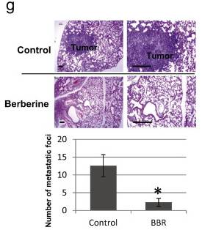
Berberine –HCC Xenograft
Inhibits Lung Mets
Tsang, Chi Man, et al. "Berberine inhibits the growth and development of lung metastases in hepatocellular carcinoma."
(2015): 541-551.
Notes:
Tsang, Chi Man, et al. "Berberine suppresses Id-1 expression and inhibits the growth and development of lung metastases in hepatocellular carcinoma." Biochimica et Biophysica Acta (BBA)-Molecular Basis of Disease 1852.3 (2015): 541-551.

Slide 61
Berberine – Epiphany Against Cancer
Ortiz, Luis Miguel Guamán, et al. "Berberine, an Epiphany Against Cancer." Molecules 19 (2014): 12349-12367.6.
Notes:
Ortiz, Luis Miguel Guamán, et al. "Berberine, an Epiphany Against Cancer." Molecules 19 (2014): 12349-12367.

Slide 62
Berberine – WNT Inhibitor
Berberine acts as a natural inhibitor of Wnt/β-catenin Albring KF1, etal. Biofactors. 2013 Nov-Dec;39(6):652-62.
Signaling pathways affected by berberine, MAP (mitogen-activated protein kinase) and
Wnt/β-catenin pathways, are critical for reducing cellular migration and sensitivity to various growth factors. Eur J Pharmacol. 2014 Oct 5;740:584-95. Targets and mechanisms of berberine, a natural drug with potential to treat cancer with special focus on breast cancer. Jabbarzadeh Kaboli P1, Rahmat A2, Ismail P3, Ling KH4.
Notes:
Biofactors. 2013 Nov-Dec;39(6):652-62. Berberine acts as a natural inhibitor of Wnt/β-catenin signaling--identification of more active 13-arylalkyl derivatives. Albring KF1, Weidemüller J, Mittag S, Weiske J, Friedrich K, Geroni MC, Lombardi P, Huber O.
Eur J Pharmacol. 2014 Oct 5;740:584-95. Targets and mechanisms of berberine, a natural drug with potential to treat cancer with special focus on breast cancer.Jabbarzadeh Kaboli P1, Rahmat A2, Ismail P3, Ling KH4.

Slide 63
Milk Thistle Psylibin Phytosome
inhibited Wnt/β-catenin signaling by suppressing Wnt co-receptor LRP6 expression in human breast cancer cells MDA-MB-231 and T-47D
Tiwari, Prabha, and K. P. Mishra. “Silibinin in cancer therapy: A promising prospect.” Cancer Research Frontiers 1.3 (2015): 303-318.
Notes:
Tiwari, Prabha, and K. P. Mishra. “Silibinin in cancer therapy: A promising prospect.” Cancer Research Frontiers 1.3 (2015): 303-318.

Slide 64
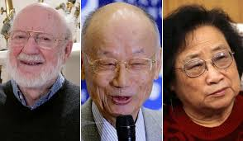
Ivermectin
William C. Campbell and Satoshi Ōmura
Nobel Prize 2015
Revolutionary drug 1970’s
Originating from a single Japanese soil sample
Streptomyces avermitilis
Notes:
CRUMP A, ŌMURA S. Ivermectin, “Wonder drug” from Japan: the human use perspective. ŌMURA S, ed. Proceedings of the Japan Academy Series B, Physical and Biological Sciences. 2011;87(2):13-28. doi:10.2183/pjab.87.13.

Slide 65
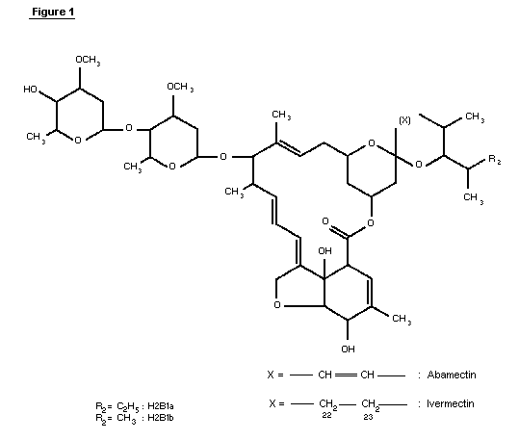
Ivermectin Chemical Structure

Slide 66

Ivermectin
Ivermectin
Stromectol for humans
Ivomec for Dogs
Wonder Drug From Japan Crump 2011
Notes:
CRUMP A, ŌMURA S. Ivermectin, “Wonder drug” from Japan: the human use perspective. ŌMURA S, ed. Proceedings of the Japan Academy Series B, Physical and Biological Sciences. 2011;87(2):13-28. doi:10.2183/pjab.87.13.

Slide 67
Ivermectin Treatment in Humans
Lice (Pediculosis) and
Scabies (Mites
Parasites such as Nematodes,
Onchocerciasis, (river blindness)
Strongyloidiasis,
Ascariasis,
cutaneous larva migrans,
Filariases,
Gnathostomiasis and
Trichuriasis.

Slide 68
Ivermectin Safety
About 200 million are currently taking Ivermectin as treatment/prevention of river blindness.
“astonishingly safe for human use.”
“Indeed, it is such a safe drug, with minimal side effects, that it can be administered by non-medical staff and even illiterate individuals in remote rural communities,”
CRUMP A, ŌMURA S. Ivermectin, “Wonder drug” from Japan 2011.
Notes:
CRUMP A, ŌMURA S. Ivermectin, “Wonder drug” from Japan: the human use perspective. ŌMURA S, ed. Proceedings of the Japan Academy Series B, Physical and Biological Sciences. 2011;87(2):13-28. doi:10.2183/pjab.87.13.

Slide 69
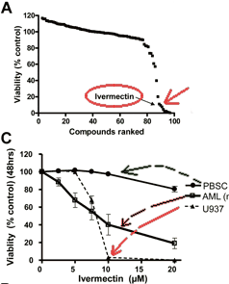
Ivermectin Leukemia Cells
Sharmeen S, et al. The antiparasitic agent ivermectin induces chloride-dependent membrane hyperpolarization and cell death in leukemia cells. Blood. 2010;116(18):3593–3603. clinical investigation 123.1 (2013): 315-328.
Notes:
Sharmeen S, et al. The antiparasitic agent ivermectin induces chloride-dependent membrane hyperpolarization and cell death in leukemia cells. Blood. 2010;116(18):3593–3603. doi: 10.1182/blood-2010-01-262675.
Sukhai, Mahadeo A., et al. “Lysosomal disruption preferentially targets acute myeloid leukemia cells and progenitors.” The Journal of clinical investigation 123.1 (2013): 315-328.

Slide 70
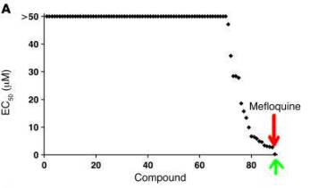
Ivermectin – Leukemia Cells
Sharmeen S, et al. The antiparasitic agent ivermectin induces chloride-dependent membrane hyperpolarization and cell death in leukemia cells. Blood. 2010;116(18):3593–3603. doi: 10.1182/blood-2010-01-262675.
Sukhai, Mahadeo A., et al. “Lysosomal disruption preferentially targets acute myeloid leukemia cells and progenitors.” The Journal of clinical investigation 123.1 (2013): 315-328.
Notes:
Sharmeen S, et al. The antiparasitic agent ivermectin induces chloride-dependent membrane hyperpolarization and cell death in leukemia cells. Blood. 2010;116(18):3593–3603. doi: 10.1182/blood-2010-01-262675.
Sukhai, Mahadeo A., et al. “Lysosomal disruption preferentially targets acute myeloid leukemia cells and progenitors.” The Journal of clinical investigation 123.1 (2013): 315-328.

Slide 71
Ivermectin Inhibits WNT Pathway
Ivermectin (FDA-approved) is a specific WNT-TCF response blocker in cancer cells at low micromolar concentrations.
Melotti, Alice, et al. “The river blindness drug Ivermectin and related macrocyclic lactones inhibit WNT‐TCF pathway responses in human cancer.” EMBO molecular medicine (2014): e201404084.
Notes:
Melotti, Alice, et al. “The river blindness drug Ivermectin and related macrocyclic lactones inhibit WNT‐TCF pathway responses in human cancer.” EMBO molecular medicine (2014): e201404084.
as a therapeutic WNT-TCF pathway response blocker to treat WNT-TCF-dependent diseases including multiple cancers.
We find that macrocyclic lactones of the Avermectin family have specific anti-WNT-TCF response activity in human cancer cells and that the clinically approved compound Ivermectin (EMEA- and FDA-approved) is a specific WNT-TCF response blocker at low micromolar concentrations.

Slide 72
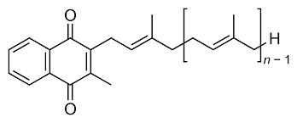
Vitamin K2 - menaquinone
Karasawa, Satoki, et al. 2013
Notes:
Karasawa, Satoki, et al. “Vitamin K2 covalently binds to Bak and induces Bak-mediated apoptosis.” Molecular pharmacology 83.3 (2013): 613-620.
Mol Pharmacol. 2013 Mar;83(3):613-20.

Slide 73
Vitamin K2 - menaquinone
Vitamin K2 induces “Apoptosis” in Glioblastoma, Hepatocellular Cancer, Lung Cancer, Prostate Cancer, etc.
Vitamin K2 (45mg per day)
VK2 directly interacts with Bak (Bcl-2 antagonist killer) and induces mitochondrial-mediated apoptosis.
Karasawa, Satoki, et al. 2013
Notes:
Karasawa, Satoki, et al. “Vitamin K2 covalently binds to Bak and induces Bak-mediated apoptosis.” Molecular pharmacology 83.3 (2013): 613-620.
Mol Pharmacol. 2013 Mar;83(3):613-20.

Slide 74
Melatonin 20 mg QHS
Inhibits Cancer Stem Cells
inhibitory effect of melatonin in cancer stem cells.
treatment with melatonin decrease the cell proliferation and induced the cell death by apoptosis and autophagy of colorectal and glioma Cancer stem cells
Crosses BBB
Notes:
do Nascimento Gonçalves, Naiane, et al. "Effect of Melatonin in Epithelial Mesenchymal Transition Markers and Invasive Properties of Breast Cancer Stem Cells of Canine and Human Cell Lines." PloS one 11.3 (2016): e0150407.
Ordoñez, R., et al. "Ceramide metabolism regulates autophagy and apoptotic cell death induced by melatonin in liver cancer cells." Journal of pineal research 59.2 (2015): 178.

Slide 75
Retinoids, Vitamin A Derivatives
Beta Carotene, Accutane etc.
Induces Cellular Differentiation
ATRA approved for Pro-Myelocytic Leukemia
Bexarotene Approved Cutaneous T-Cell Lymphoma
Useful in the post menopausal age group.
Avoid in Younger ages - Teratogenic effects
Birth Defects in Women of Child Bearing Age.
Notes:
Orlandi, M., et al. "Retinoids and cancer: antitumoral effects of ATRA, 9-cis RA and the new retinoid IIF on the HL-60 leukemic cell line." Medical Principles and Practice 12.3 (2003): 164-169.
Mueller, Beatrice U., et al. "ATRA resolves the differentiation block in t (15; 17) acute myeloid leukemia by restoring PU. 1 expression." Blood 107.8 (2006): 3330-3338.
Wong, Siu-Fun. "Oral bexarotene in the treatment of cutaneous T-cell lymphoma." Annals of Pharmacotherapy 35.9 (2001): 1056-1065.

Slide 76
Mefloquin Synergy
With Artemisinin
Combined Therapy Established Treatment
Pharmacokinetics Thoroughly Studied
Dosing Established for Malaria Treatment.
Retinal and Neurotoxicity an Issue
Replaced by Hydroxychloroquin – eight clinical trials . (Solitro 2016)
Ivermectin More effective and safer.
Notes:
Solitro, A. R., and J. P. MacKeigan. “Leaving the lysosome behind: novel developments in autophagy inhibition.” Future medicinal chemistry 8.1 (2016): 73.

Slide 77
Antibiotics are Anti-Cancer
Ciprofloxin, Doxycyline and other commonly used antibiotics inhibit mitochondrial biogenesis in cancer stem cells and may ultimately find their place in routine use as anti-cancer stem cell agents.
Lamb, Rebecca, et al. “Antibiotics that target mitochondria effectively eradicate cancer stem cells, across multiple tumor types: Treating cancer like an infectious disease.”
Notes:
Lamb, Rebecca, et al. “Antibiotics that target mitochondria effectively eradicate cancer stem cells, across multiple tumor types: Treating cancer like an infectious disease.”

Slide 78
There are Many More
Vitamin D
Thymoquinone (Black Seed Cumin Oil)
Bee Propolis Caffeic acid phenethyl ester
Paw Paw
Graviola

Slide 79
Conclusion
We have presented the case for non- toxic targeted cancer therapies for addressing both tumor mass burder, and cancer stem cells which are resistant to conventional chemotherapy.

Slide 80
Thank You – Any Questions?
TrueMedMD 7450 Griffin Road Suite 180/190 Davie, Fl 33314
954-792-4663 www.jeffreydachmd.com
Slides Available at: http://jeffreydachmd.com

Slide 81
Berberine Effects
Blocks Toll Receptors in LPS Treated mice. Chu 2014 (80)
Anti-Endotoxin
Effective for Acute Diarrhea.
Inhibits Bio-Film Formation.
Active Against Chlamydia, MERSA etc.(88) Chu 2014
Anti- Microbial
Inhibits Atherosclerosis
Anti-Arrythmia
Useful in CHF - Increases Ejection Fraction (89-91)
Heart

